Slide 1
Reference: Ortigas & Company - Website Desktop and Mobile UI - 091619
FOR CONFIRMATION
DIGIFY TO FIX
CLOSED / FIXED

Slide 2
 | 0 | 0%
 | 34 | 87.18%
 | 5 | 12.82%
TOTAL | 39 | 100%
FOR CONFIRMATION
DIGIFY TO FIX
CLOSED / FIXED

Slide 3

(SEPTEMBER 16, 2019)

Slide 4


HEADER & FOOTER (DESKTOP)
10/01/19 v 1.1.0 DOCW-202 - [Main Navigation] Incomplete no About Us and Careers, News not included
MAIN NAVIGATION
10/01/19 v 1.1.0 DOCW-201 - [Main Navigation] When Scrolled, Back to Top not included
WHEN SCROLLED
FOOTER
10/01/19 v 1.1.0 DOCW-215 - [Footer] Different User Interface

Slide 5
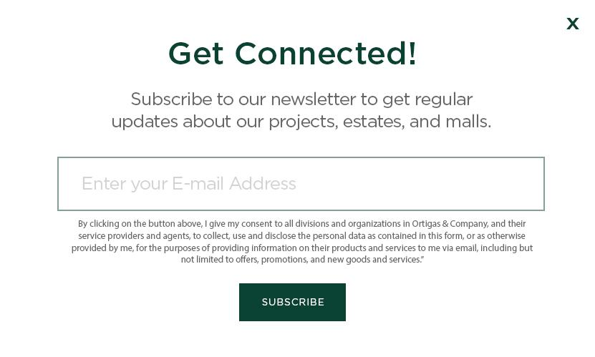
SUBSCRIBE POP-UP
10/01/19 v 1.1.0 DOCW-203 - [Subscribe Pop-Up] PHP Error was encountered

Slide 6
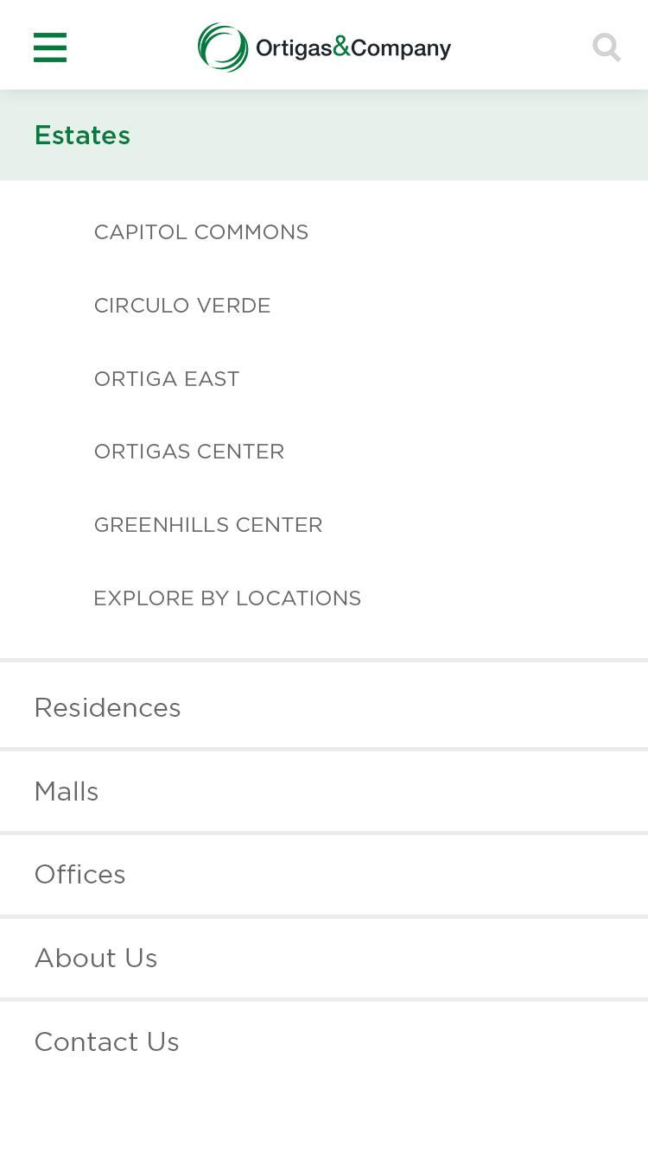



HEADER & FOOTER (MOBILE)
10/02/19 v 1.1.0 DOCW-220 - [Home] Unresponsive Burger Menu

Slide 7
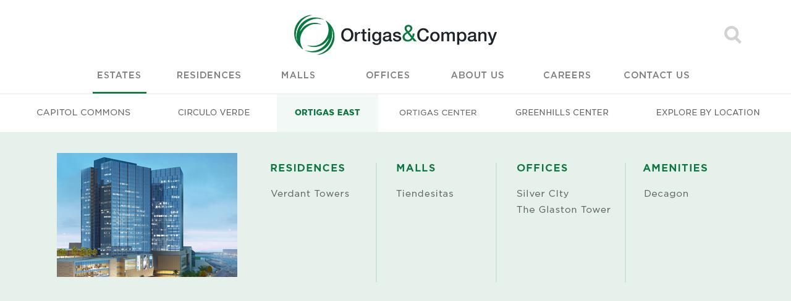
NAVIGATION DROPDOWN
ESTATES

Slide 8
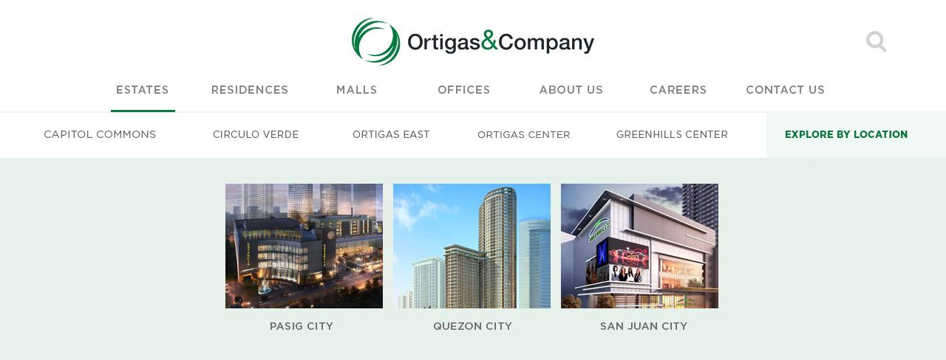
NAVIGATION DROPDOWN
ESTATES

Slide 9

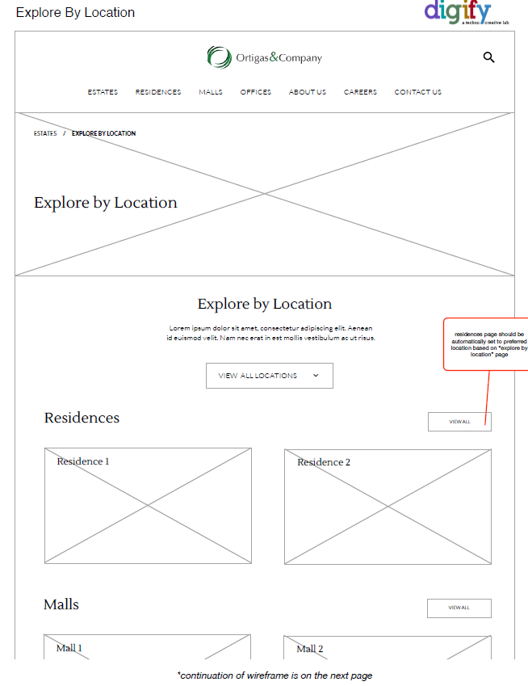
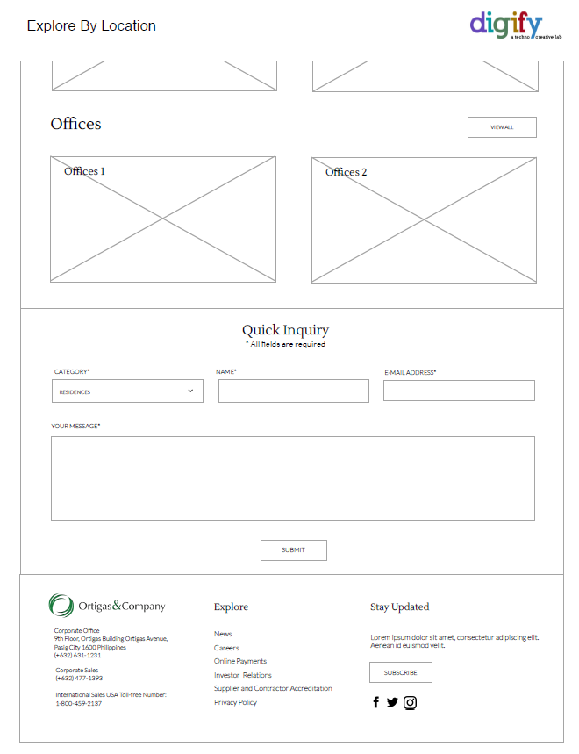
EXPLORE BY LOCATION
10/02/19 v 1.1.0 DOCW-221 - [Explore By Location] Different UI

Slide 10
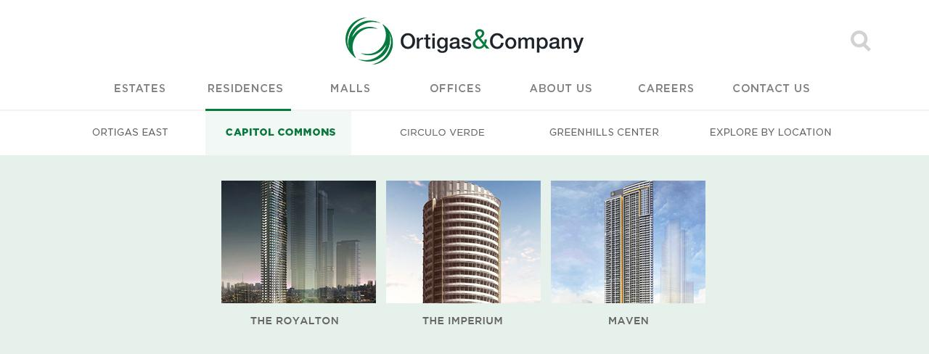
NAVIGATION DROPDOWN
RESIDENCES
10/01/19 v 1.1.0 DOCW-204 - [Residences] Missing Explore By Location Button

Slide 11
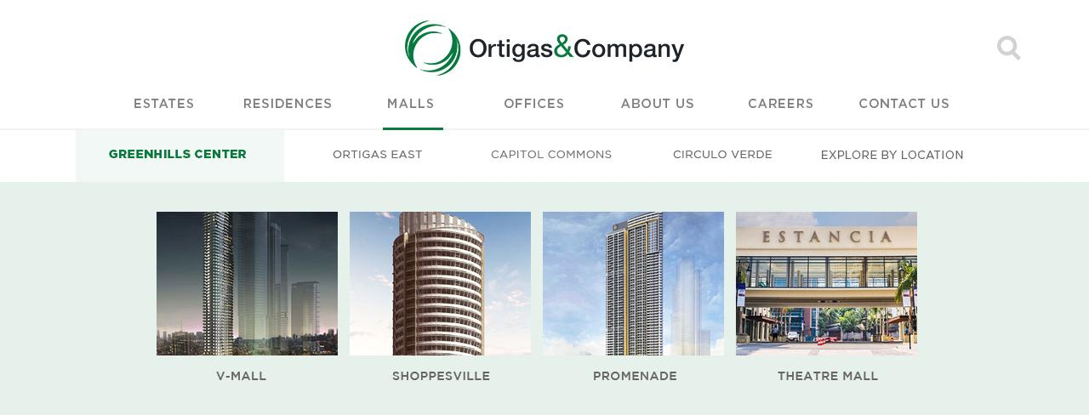
NAVIGATION DROPDOWN
MALLS
10/01/19 v 1.1.0 DOCW-205 - [Malls] Missing Ortigas East, Capitol Commons, Circulo Verde, and Explore By Location Button

Slide 12
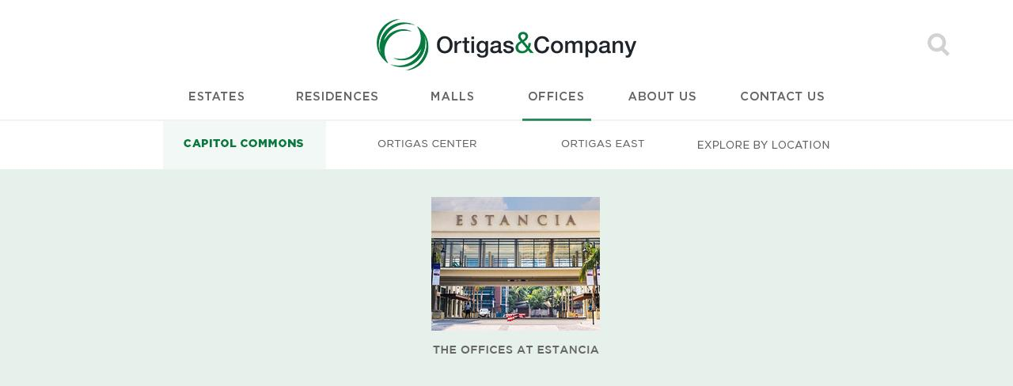
NAVIGATION DROPDOWN
OFFICES
10/01/19 v 1.1.0 DOCW-206 - [Offices] Missing Explore By Location Button, Circulo Verde and Greenhills Center are not included

Slide 13

SEARCH
10/01/19 v 1.1.0 DOCW-201 - [Main Navigation] When Scrolled, Back to Top not included
10/02/19 v 1.1.0 DOCW-253 - [Search] Search button is blinking
GLOBAL SEARCH – WHEN CLICKED
10/01/19 v 1.1.0 DOCW-207 - [Global Search] When Clicked, Malls button not included and without Ortigas logo

Slide 14

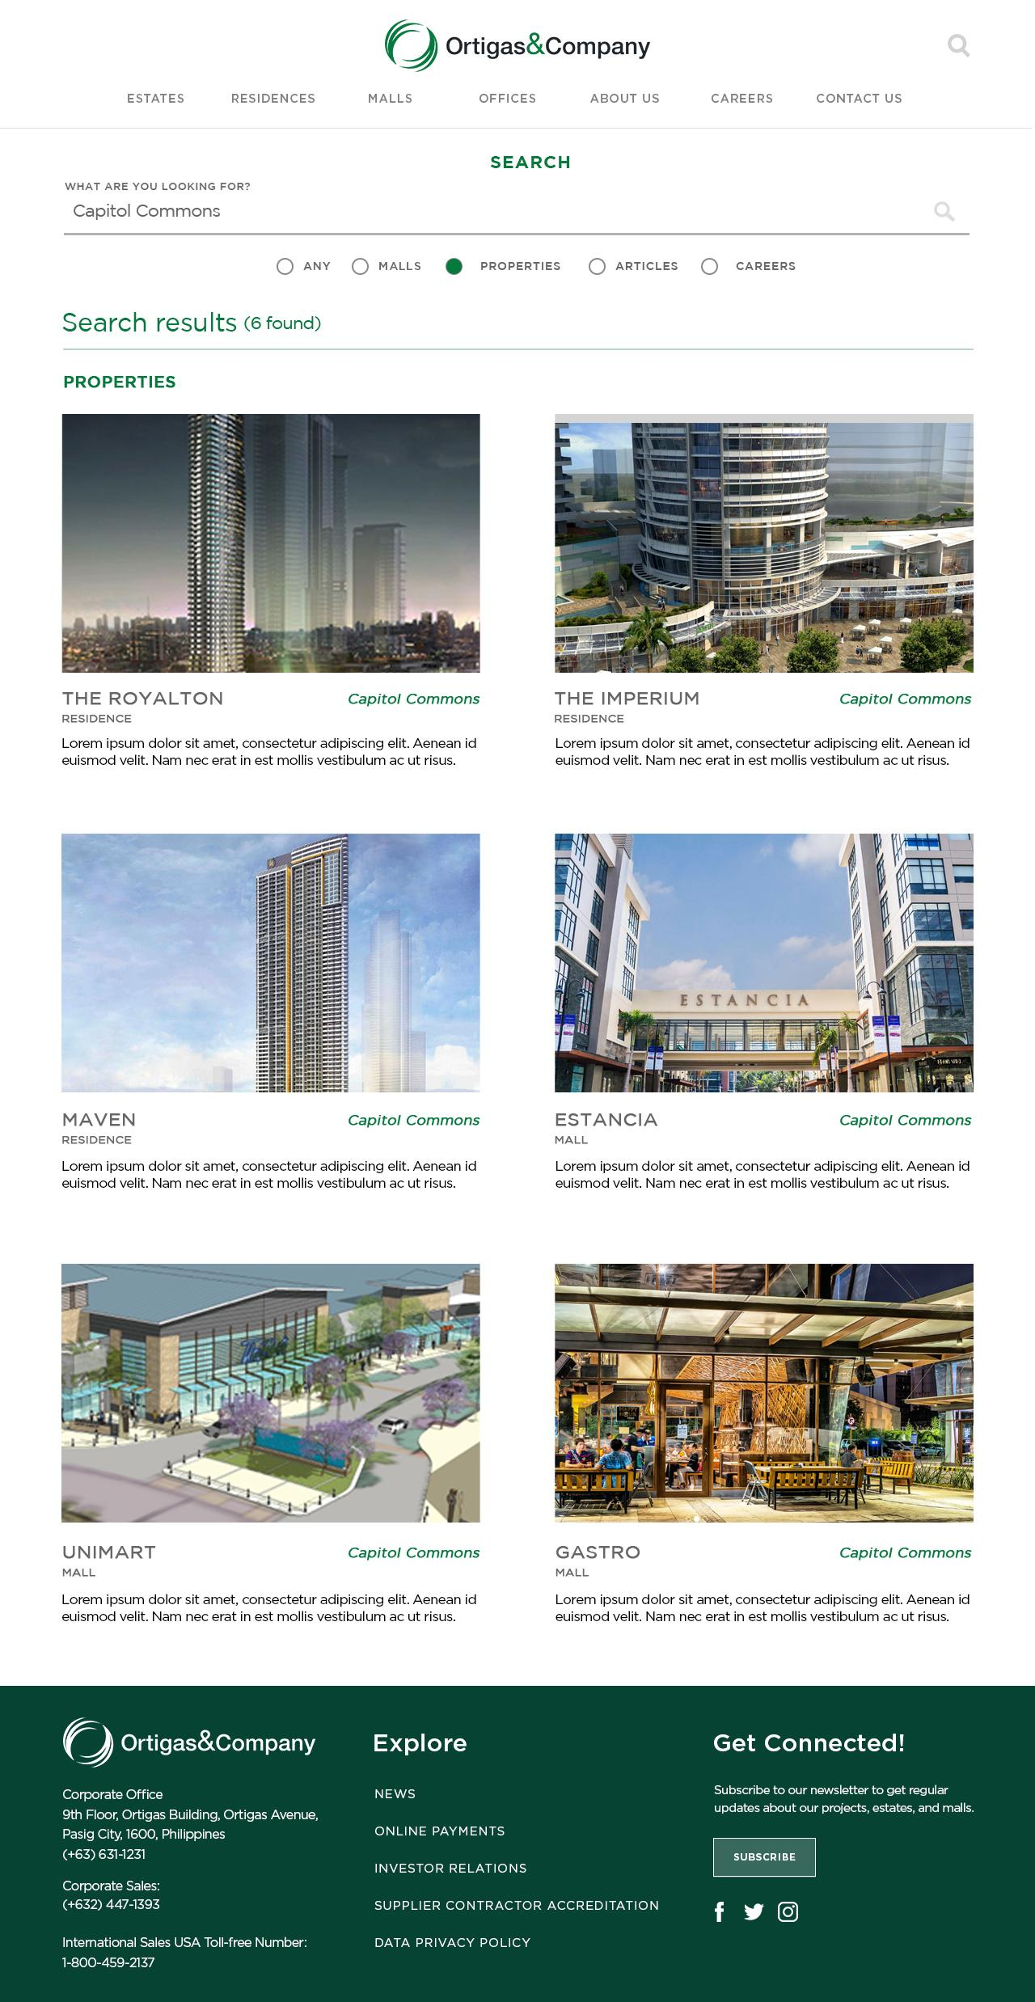

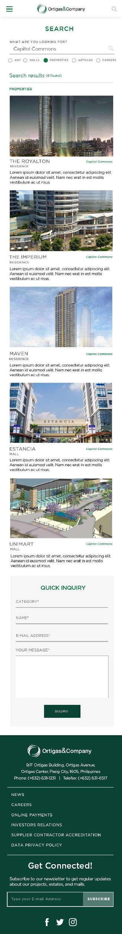
GLOBAL SEARCH - RESULTS
10/02/19 v 1.1.0 DOCW-222 - [Desktop][Global Search] Result has different User Interface
10/02/19 v 1.1.0 DOCW-223 - [Mobile][Global Search] Result has different User Interface

Slide 15
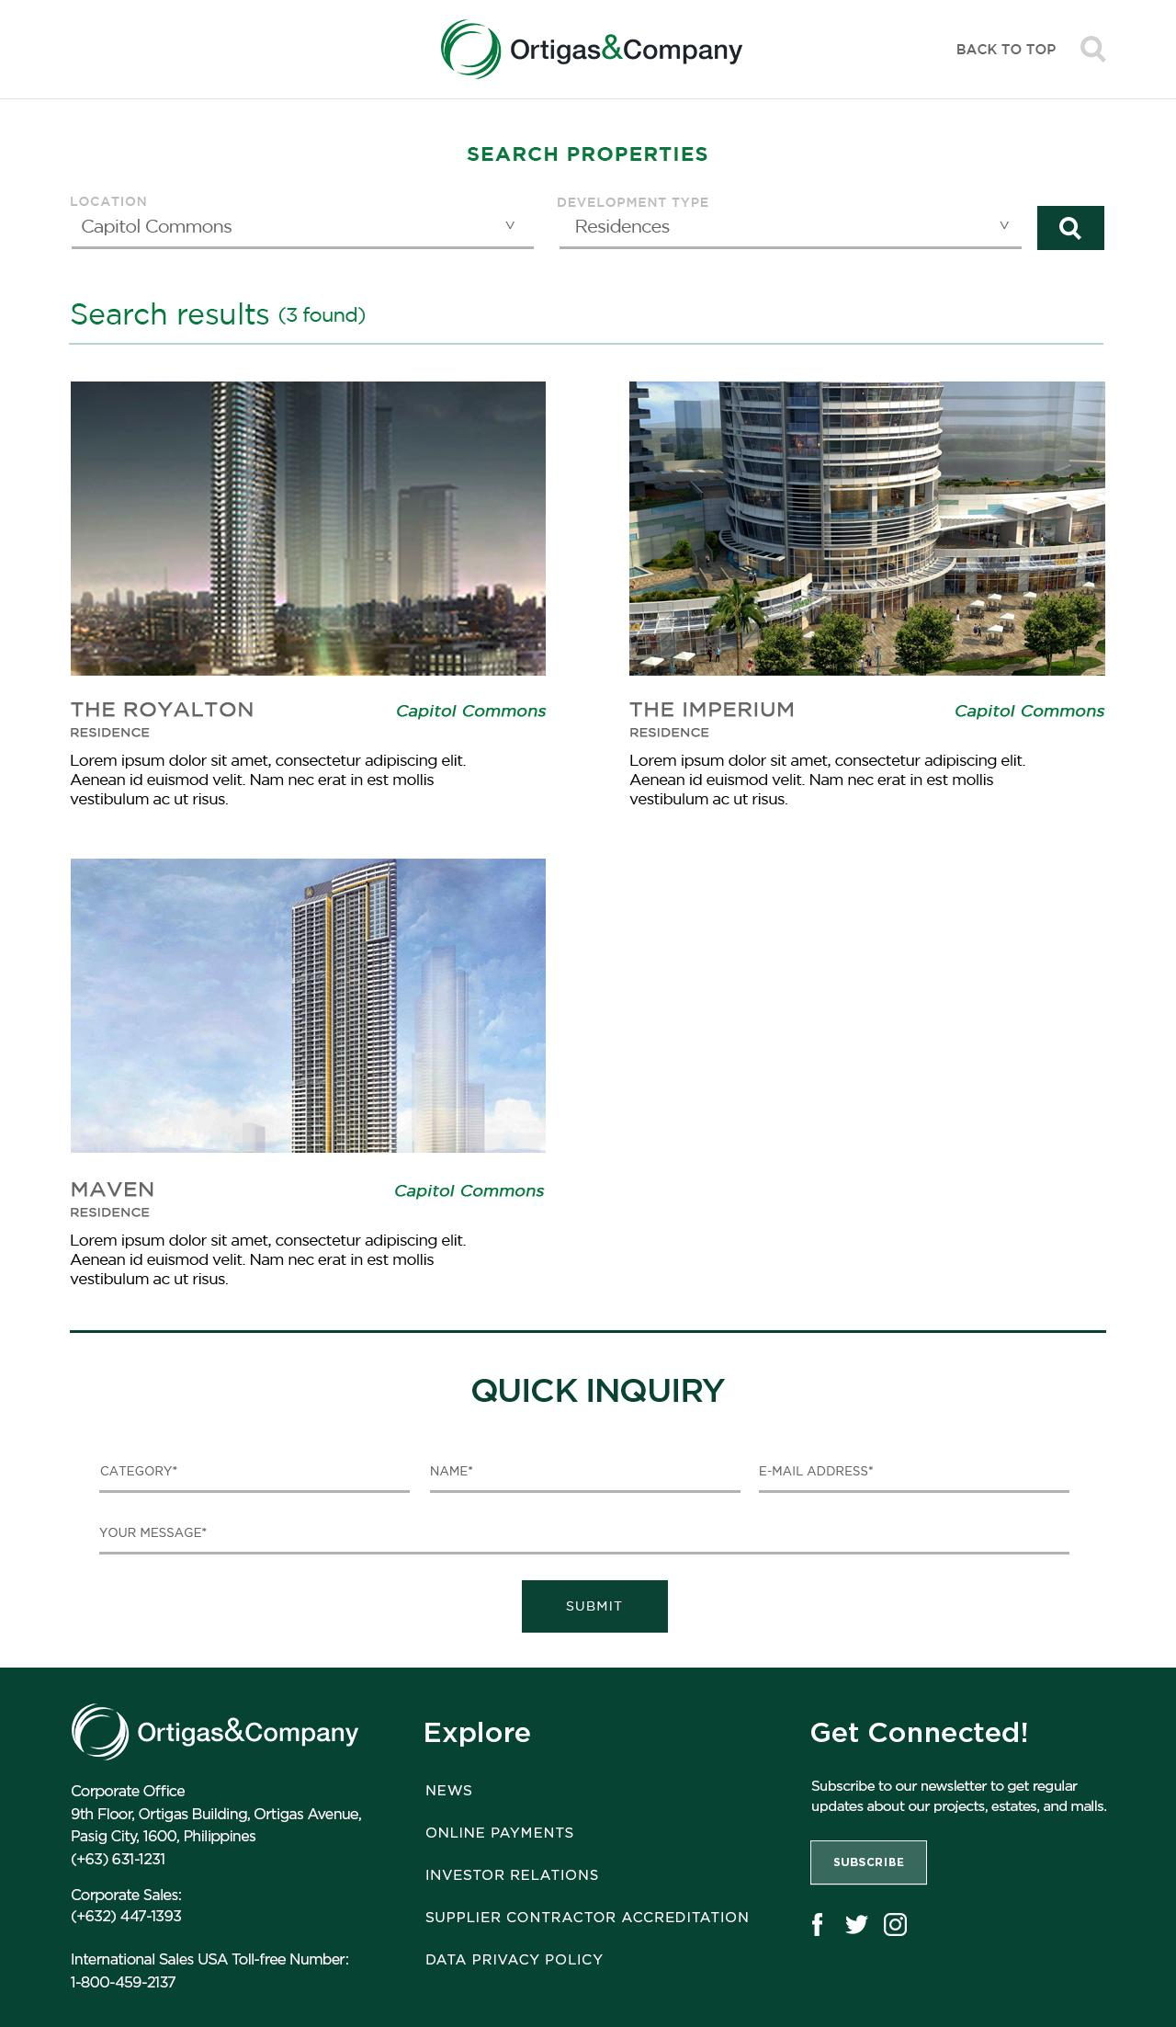
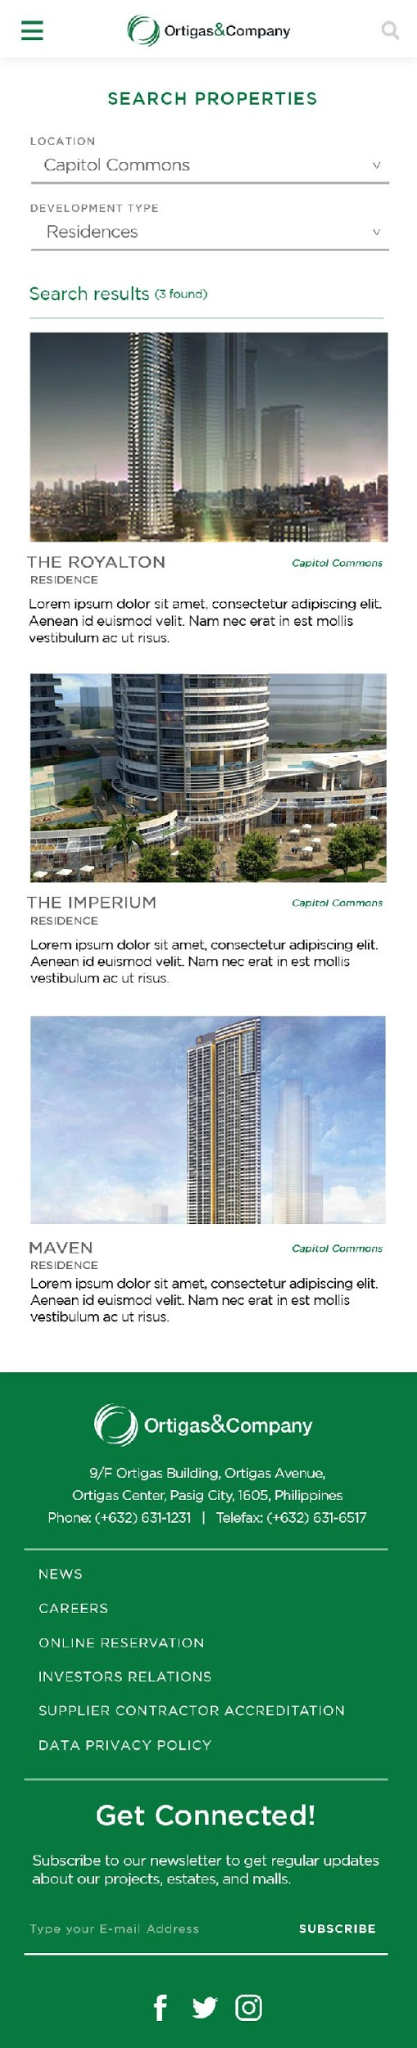
PROPERTY SEARCH - RESULTS
10/02/19 v 1.1.0 DOCW-238 - [Desktop]Global Search > Property: Incorrect copy of the search result screen.
10/02/19 v 1.1.0 DOCW-239 - [Mobile]Global Search > Property: Incorrect copy of the search result screen.

Slide 16
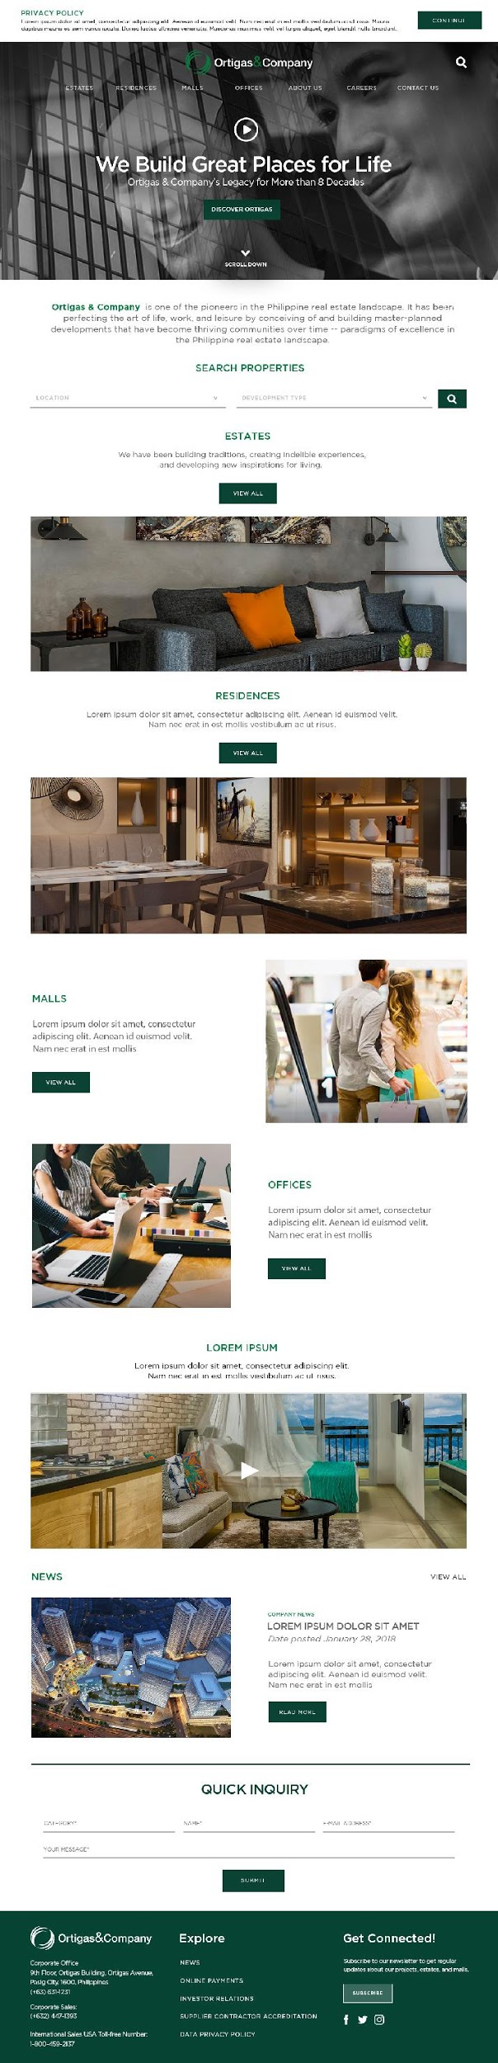
HOME
10/01/19 v 1.1.0 DOCW-208 - [Home] Discover button should be Discover Ortigas and has Scroll Down
10/01/19 v 1.1.0 DOCW-209 - [Home] Ortigas & Company has different color
10/01/19 v 1.1.0 DOCW-210 - [Home] One team, One Ortigas not included

Slide 17

HOME (MOBILE)
10/02/19 v 1.1.0 DOCW-242 - [Mobile][Home] Ortigas & Company has different color
10/02/19 v 1.1.0 DOCW-243 - [Mobile][Home] One team, One Ortigas not included
10/02/19 v 1.1.0 DOCW-244 - [Mobile][Home] Discover button should be Discover Ortigas and has Scroll Down

Slide 18
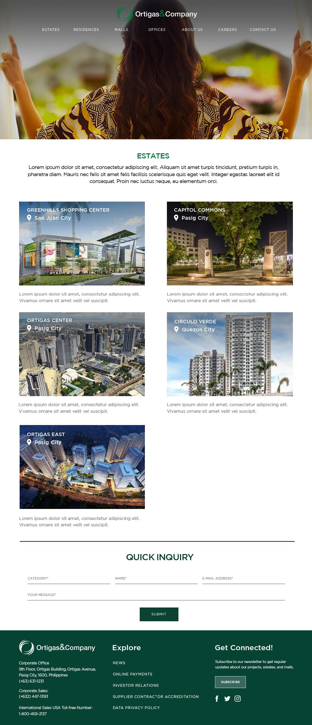

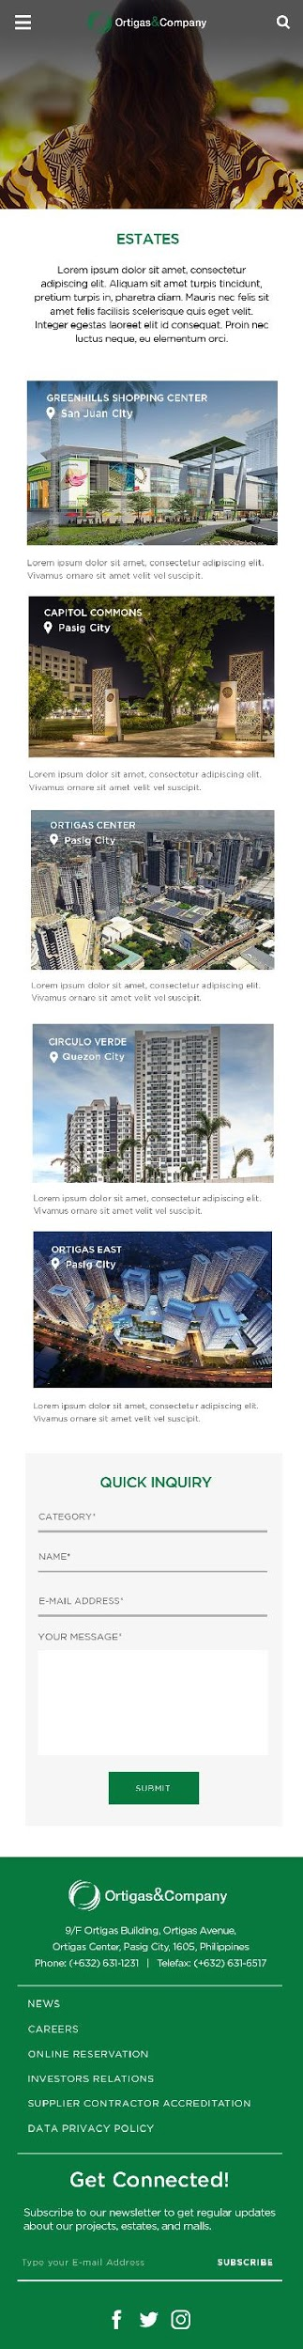
ESTATES
(DESKTOP & MOBILE)
10/02/19 v 1.1.0 DOCW-224 - [Desktop][Estates] Display is different with the UI and Recommended links are displayed
10/02/19 v 1.1.0 DOCW-225 - [Mobile][Estates] Display is different with the UI and Recommended links are displayed

Slide 19
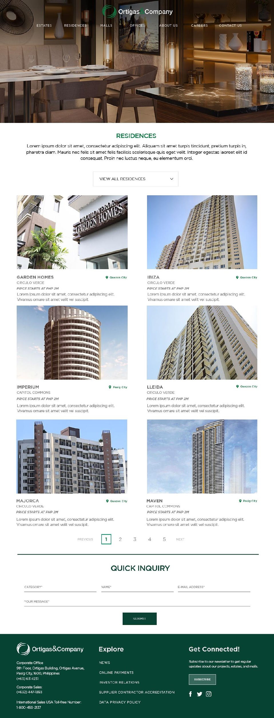
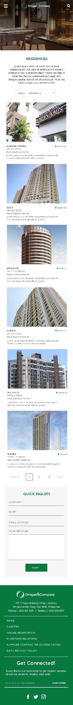
RESIDENCES
(DESKTOP & MOBILE)
10/02/19 v 1.1.0 DOCW-222 - [Desktop][Global Search] Result has different User Interface

Slide 20
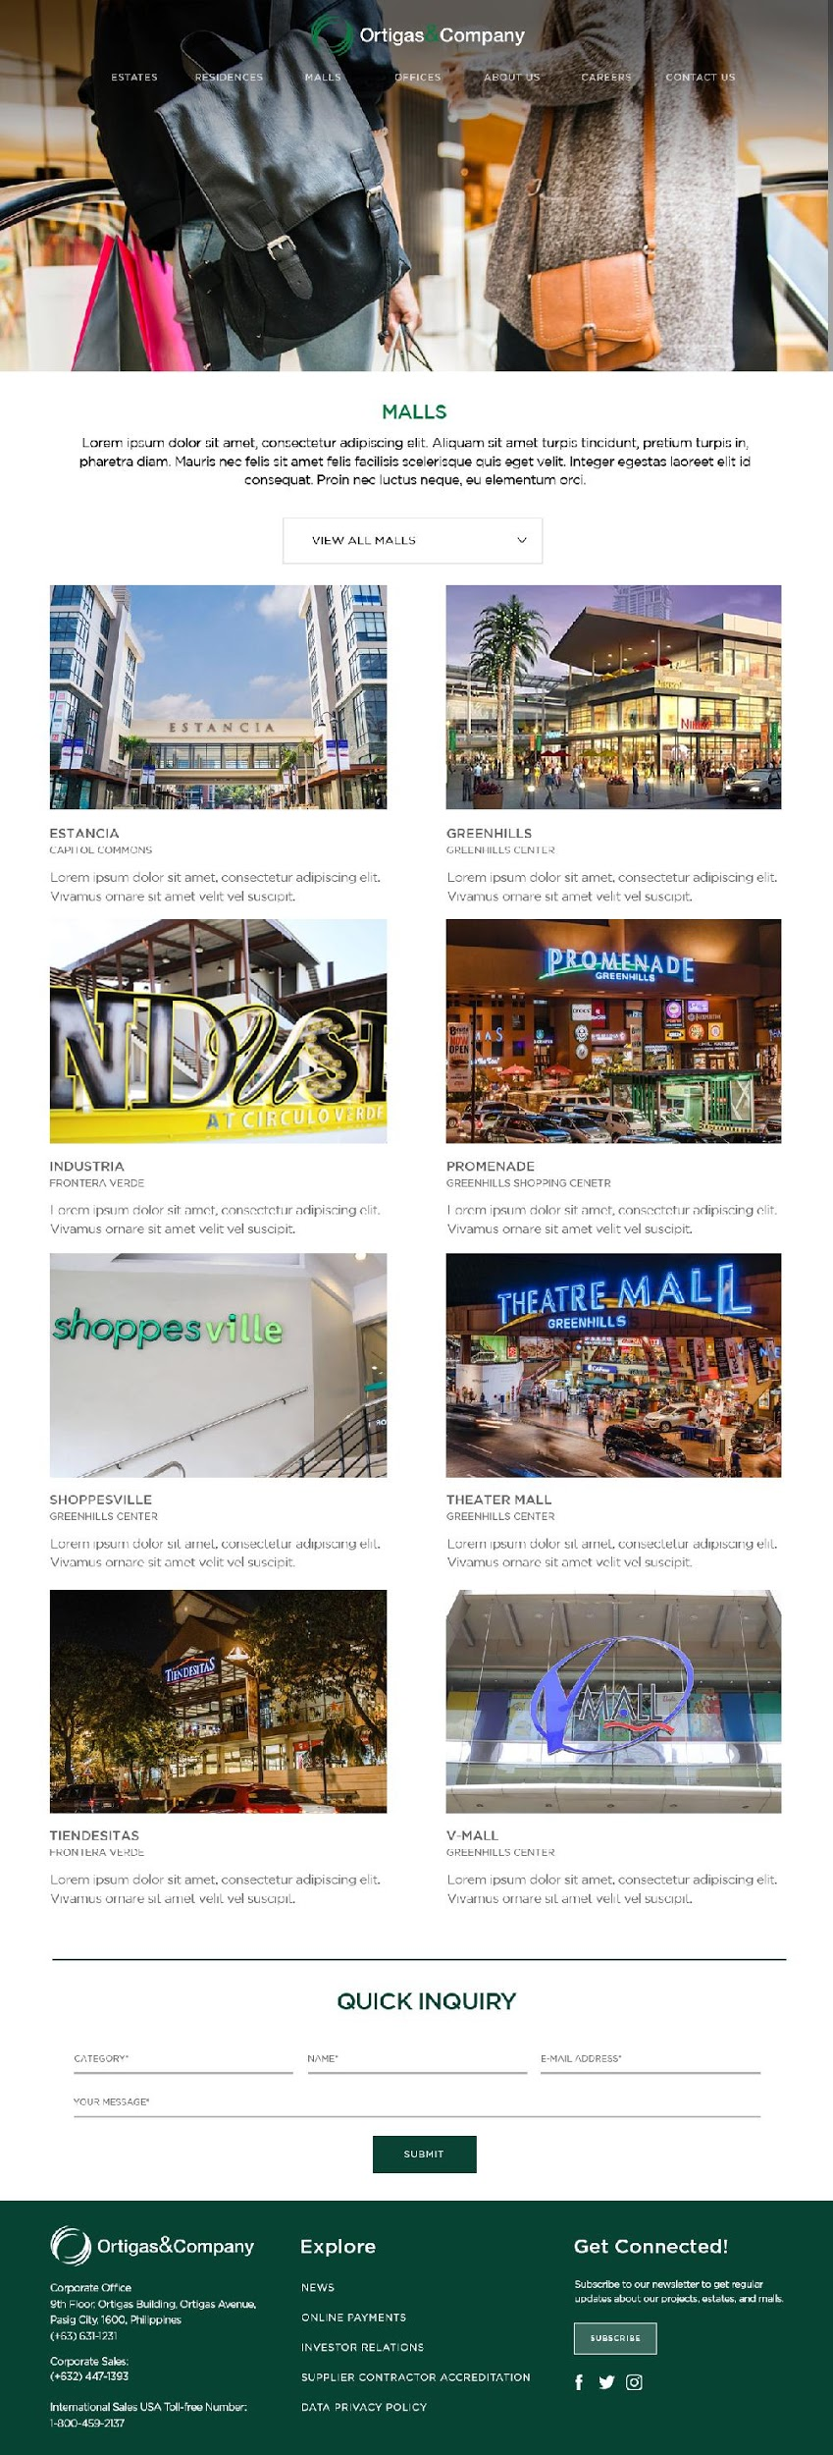
MALLS
(DESKTOP & MOBILE)

Slide 21
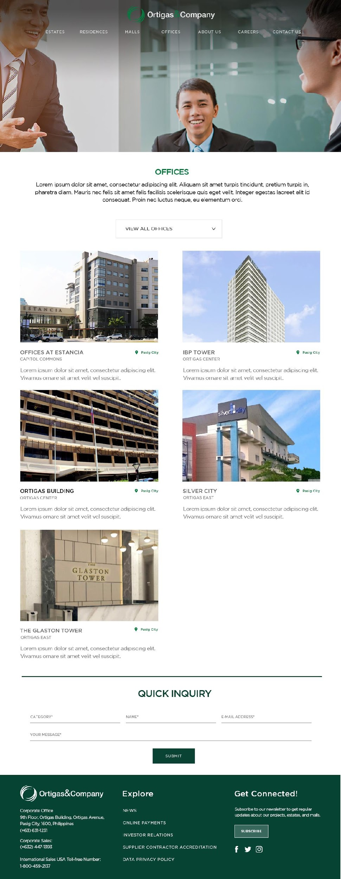
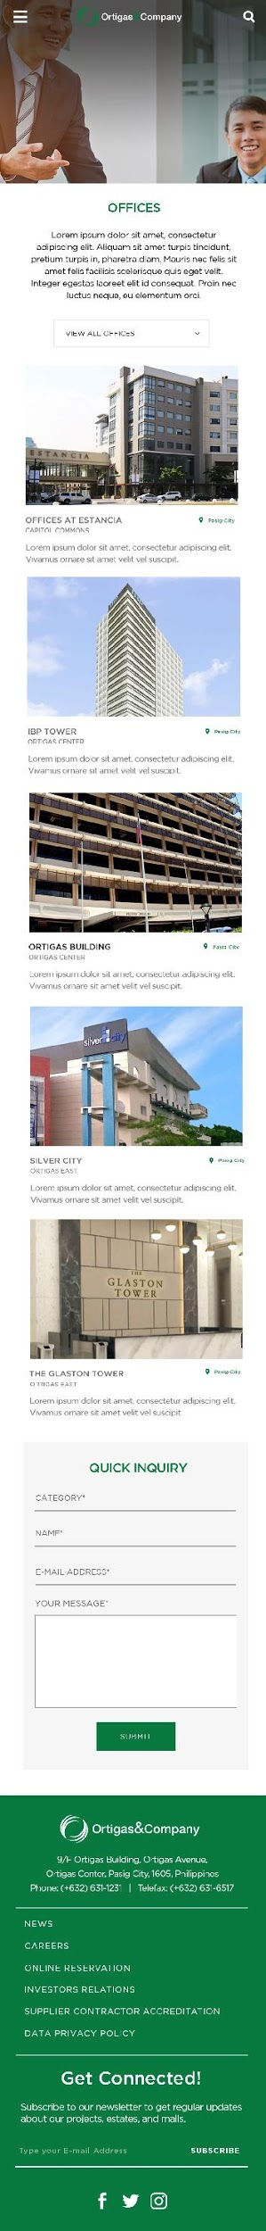
OFFICES
(DESKTOP & MOBILE)
10/02/19 v 1.1.0 DOCW-226 - [Desktop][Offices] Price Starts included in UI
10/02/19 v 1.1.0 DOCW-228 - [Desktop][Offices] Click Offices and Redirected to different Module
10/02/19 v 1.1.0 DOCW-227 - [Mobile][Offices] Click Offices and Redirected to different Module

Slide 22
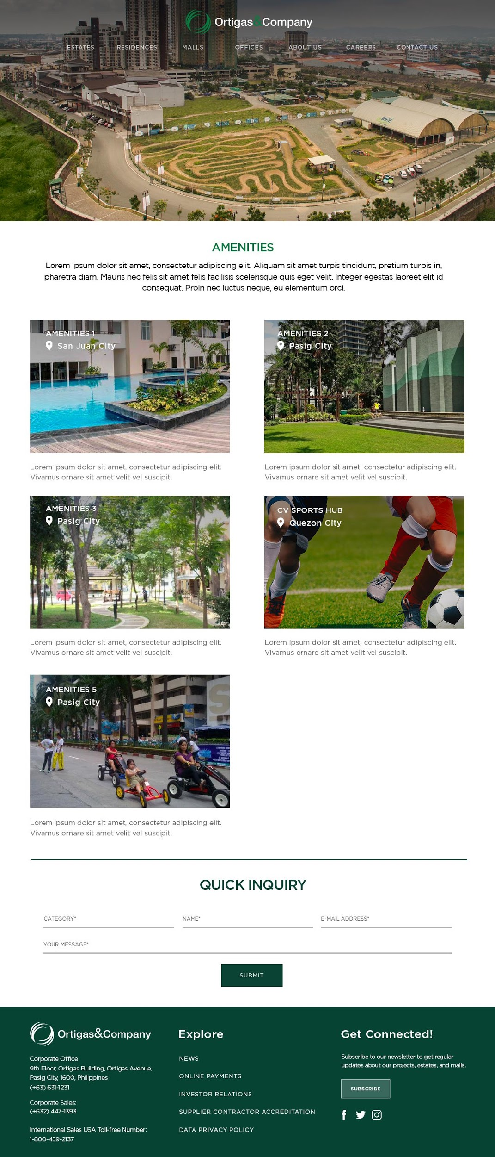
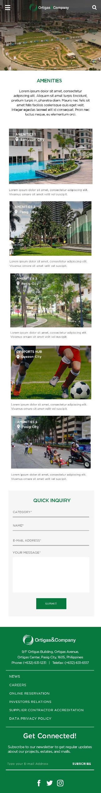
AMENITIES
(DESKTOP & MOBILE)
10/01/19 v 1.1.0 DOCW-219 - Amenity: Unable to add amenity

Slide 23
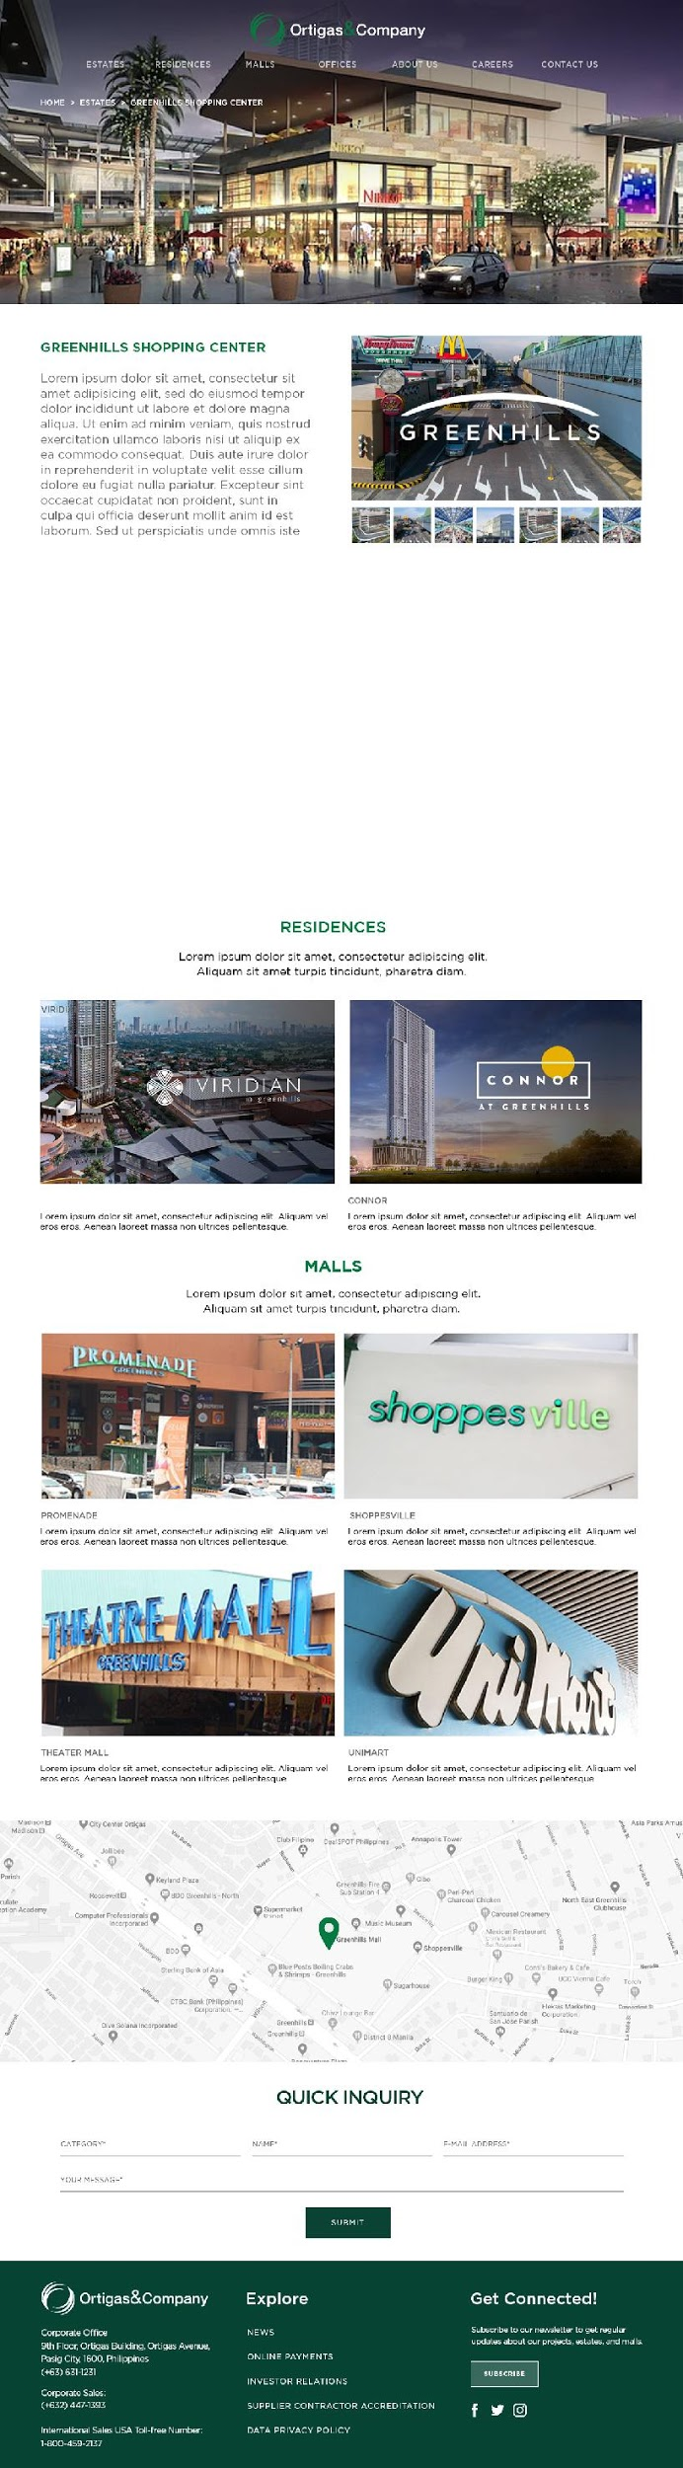
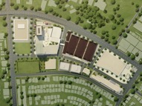
SPECIFIC ESTATE
(DESKTOP)
INTERACTIVE MAP
10/02/19 v 1.1.0 DOCW-248 - [Specific Estate] Different UI

Slide 24
SPECIFIC ESTATE (MOBILE)
10/02/19 v 1.1.0 DOCW-249 - [Mobile][Specific Estate] Different UI

Slide 25
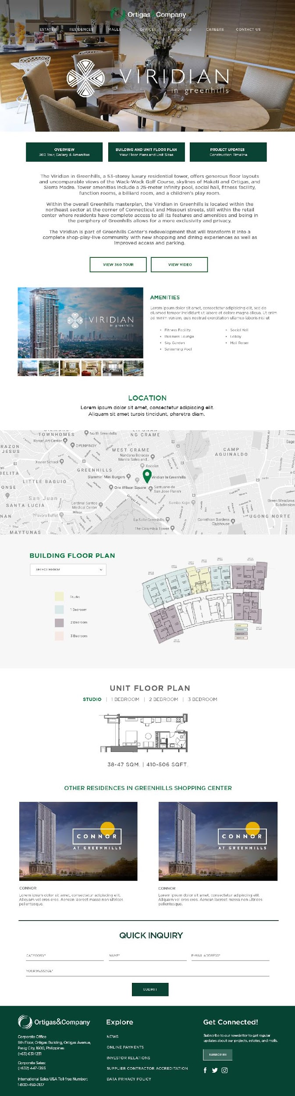
SPECIFIC RESIDENCE
(DESKTOP)
10/01/19 v 1.1.0 DOCW-217 - [Specific Residence] Header UI is misaligned on smaller screens

Slide 26
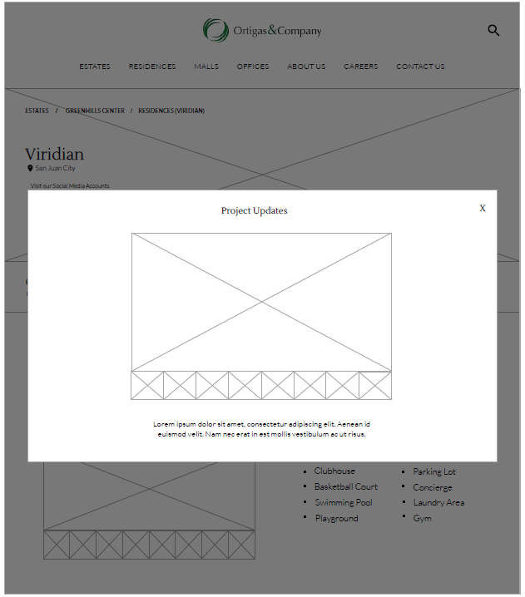
SPECIFIC RESIDENCE
(DESKTOP) - Project Updates
10/01/19 v 1.1.0 DOCW-218 - [Specific Residence] Project Updates module is not yet available on the CMS

Slide 27
SPECIFIC RESIDENCE (MOBILE)
10/02/19 v 1.1.0 DOCW-229 - [Mobile][Specific Residence] Different UI and Recommended Links included

Slide 28
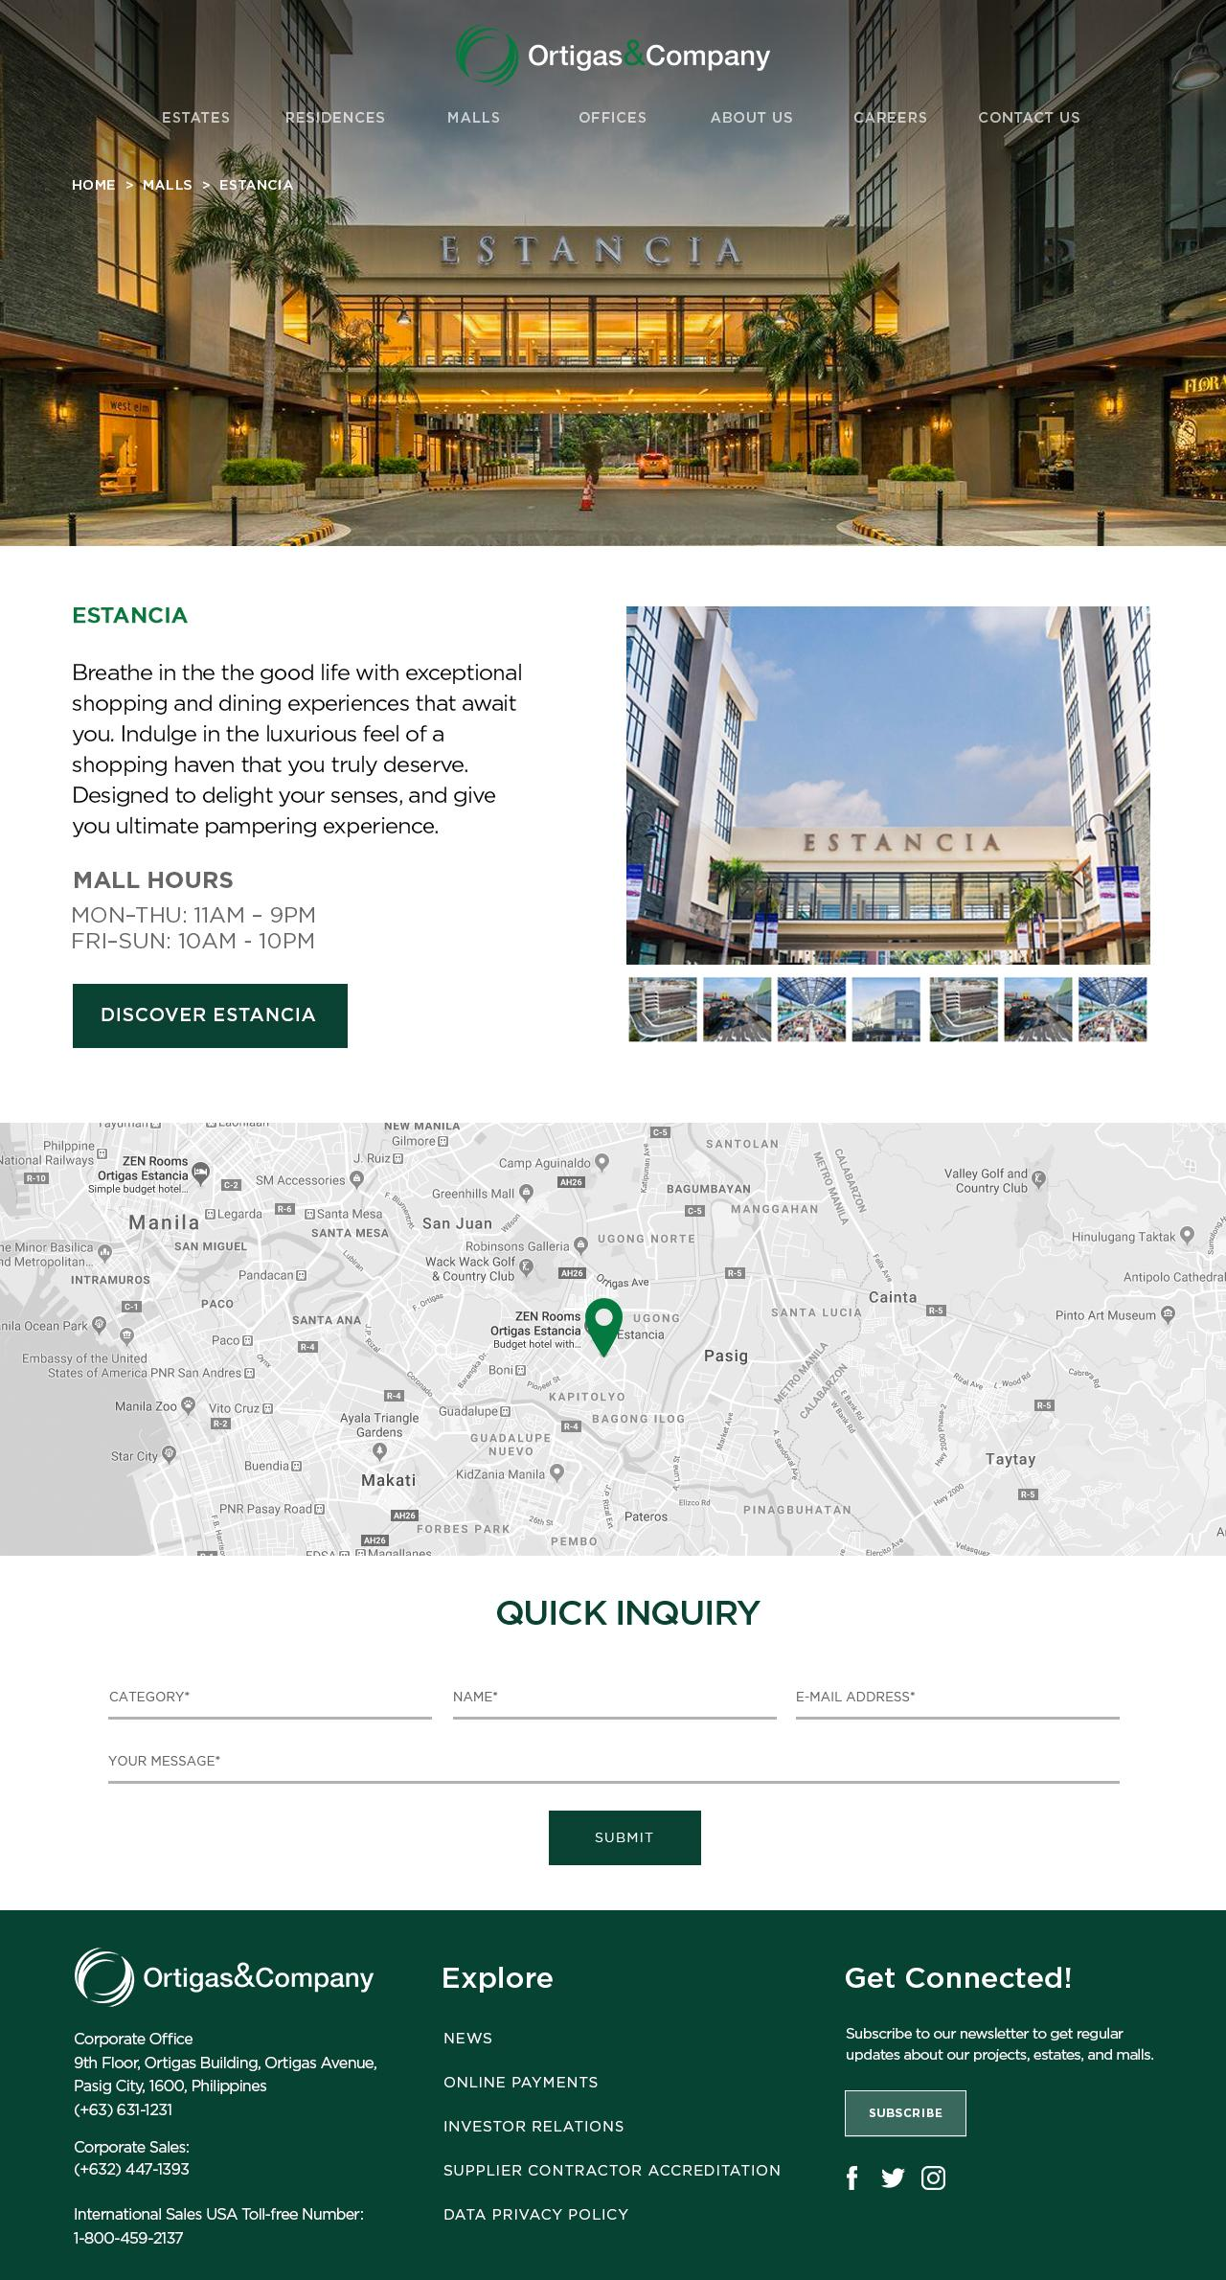
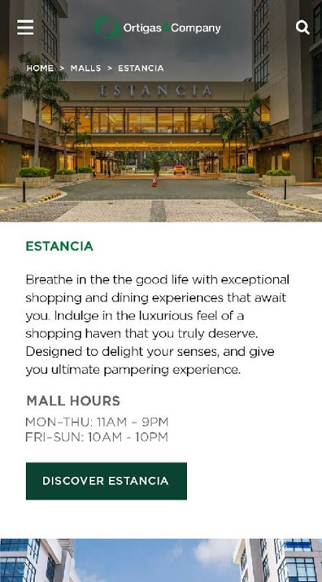
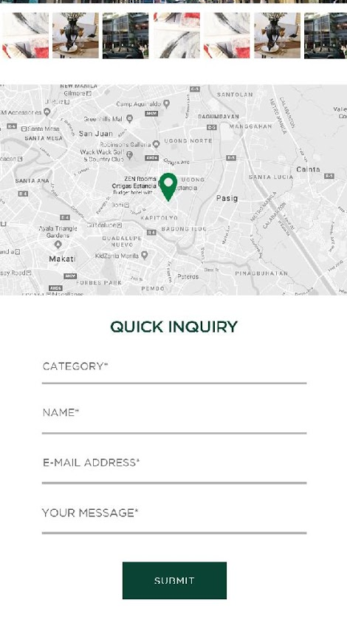
SPECIFIC MALL (DESKTOP & MOBILE)
10/02/19 v 1.1.0 DOCW-230 - [Specific Mall] Header UI is misaligned on smaller screens
10/02/19 v 1.1.0 DDOCW-231 - [Mobile][Specific Mall] Different UI

Slide 29
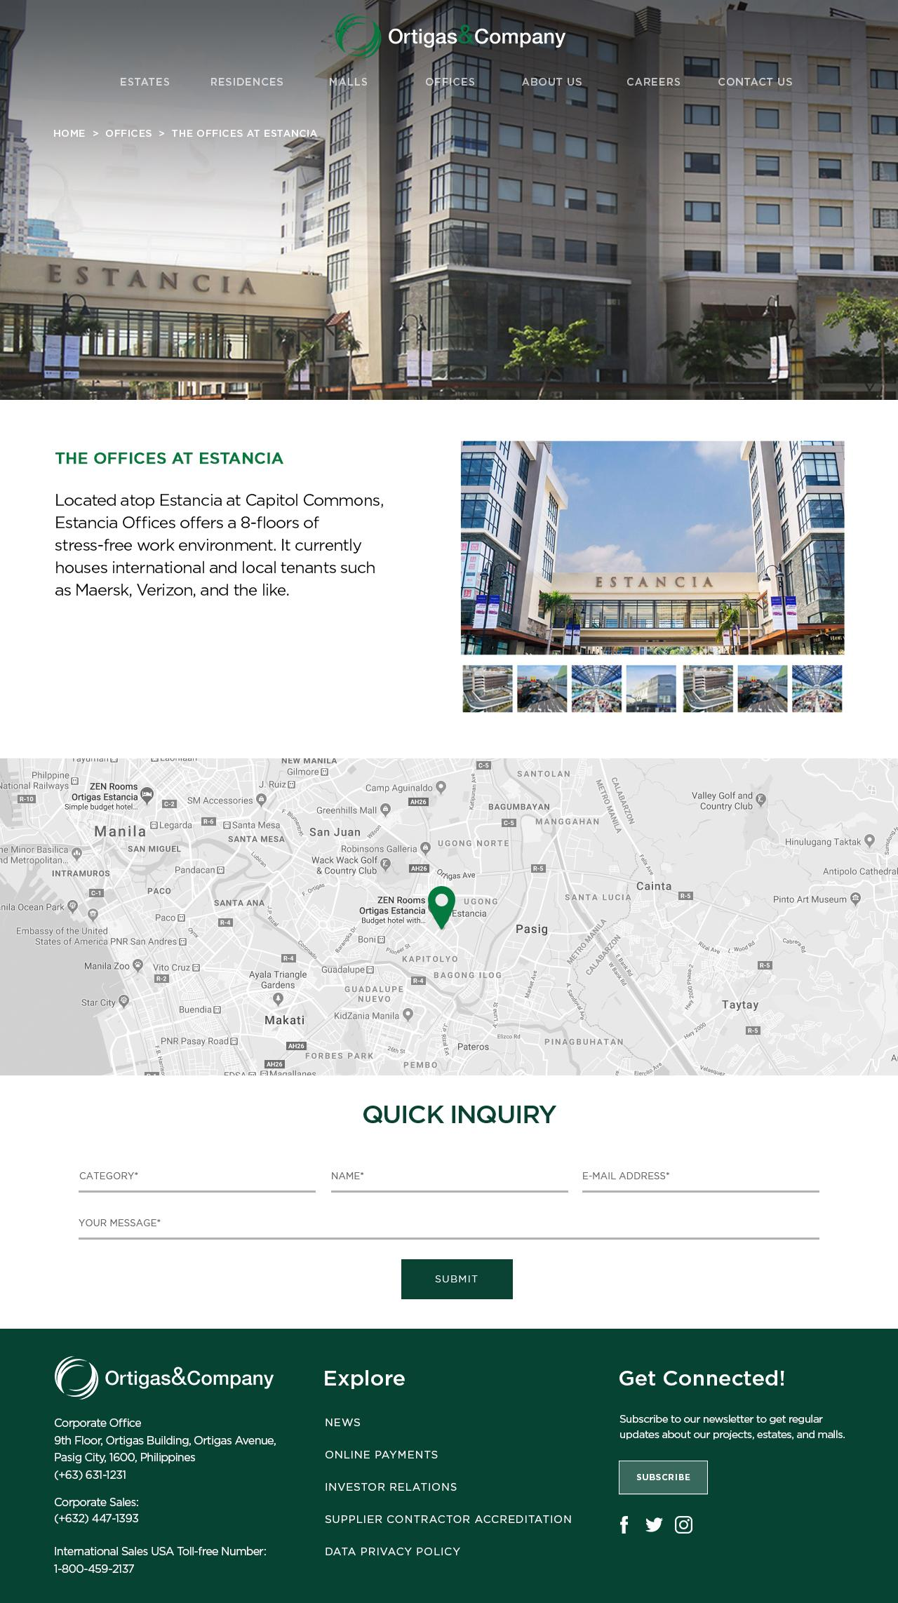
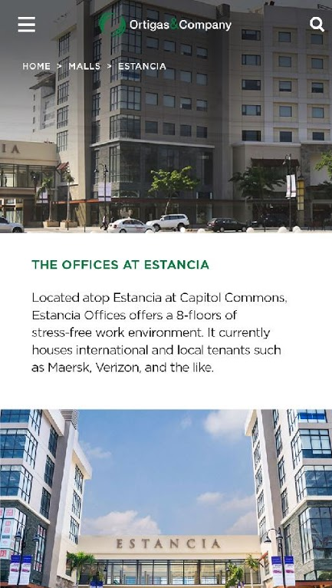
SPECIFIC OFFICES (DESKTOP & MOBILE)
Block by : v 1.1.0 DOCW-220 - [Home] Unresponsive Burger Menu and v 1.1.0 DOCW-227 - [Mobile][Offices] Click Offices and Redirected to different Module
10/02/19 v 1.1.0 DOCW-250 - [Specific Offices] Different UI

Slide 30
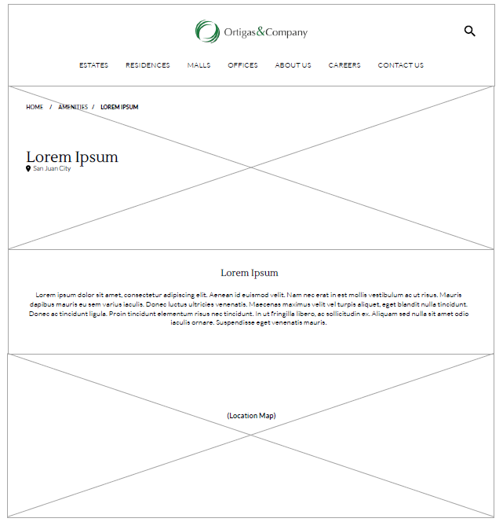
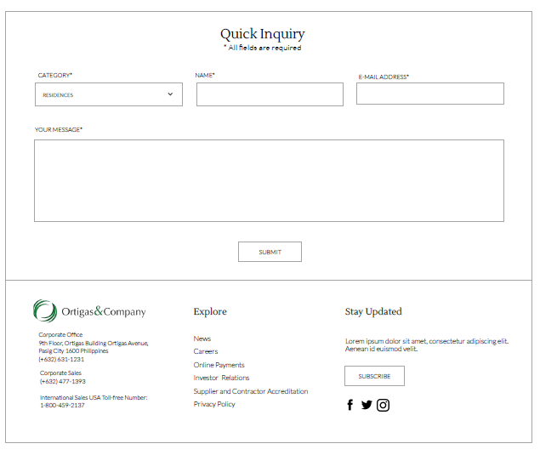
SPECIFIC AMENITY
10/01/19 v 1.1.0 DOCW-219 - Amenity: Unable to add amenity

Slide 31
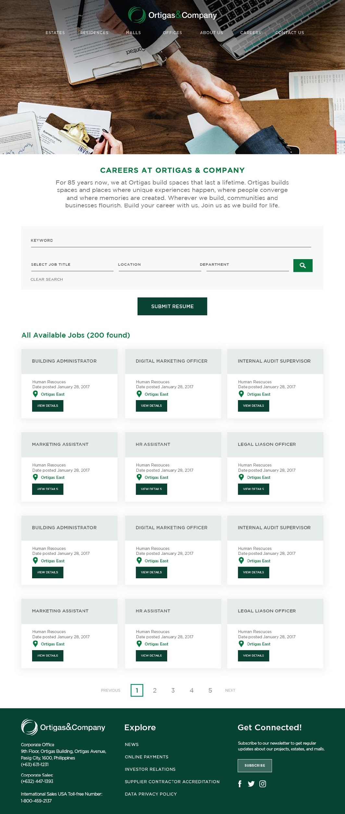

CAREERS
10/01/19 v 1.1.0 DOCW-214 - [Careers] User Interface issue and Clear Search Missing
ARRANGED BY
DATE POSTED

Slide 32

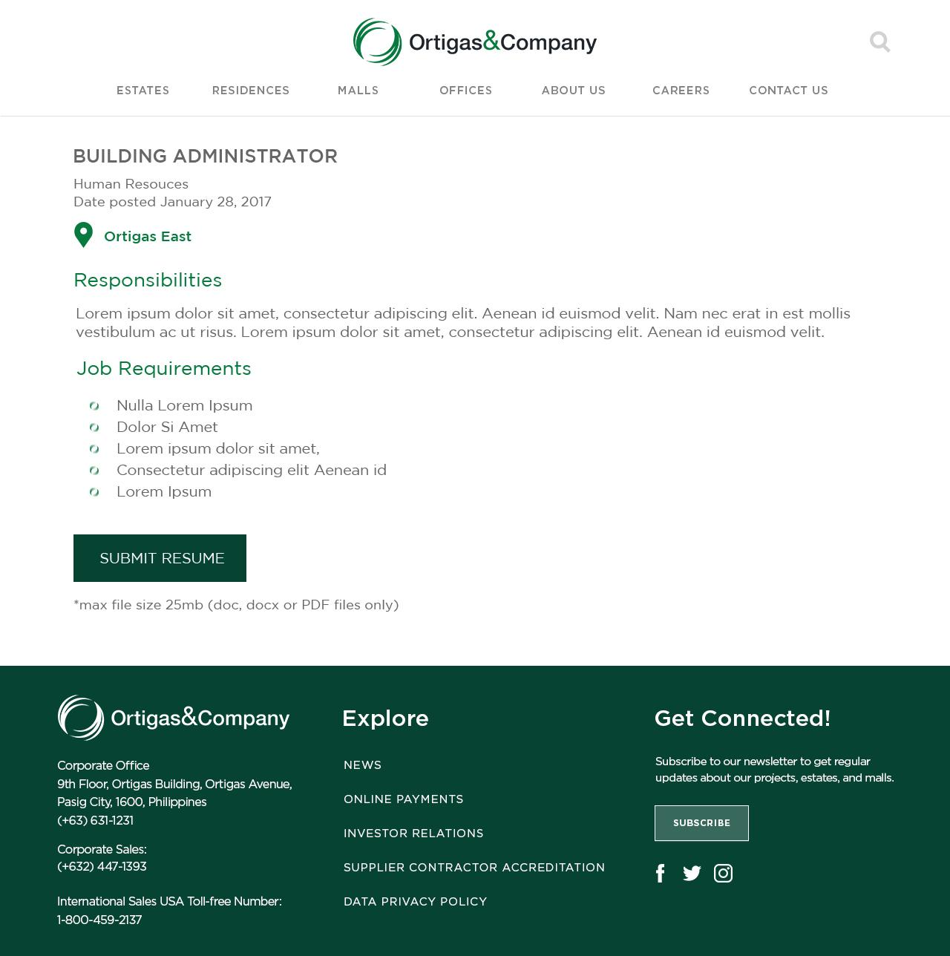
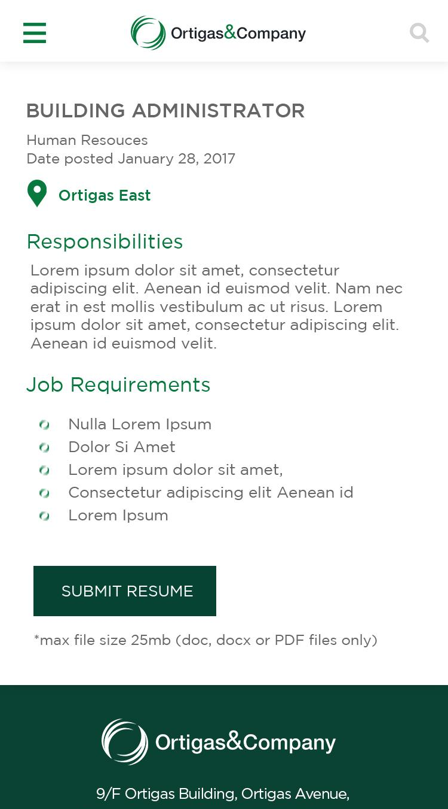
CAREERS – SELECT AVAILABLE JOB

Slide 33
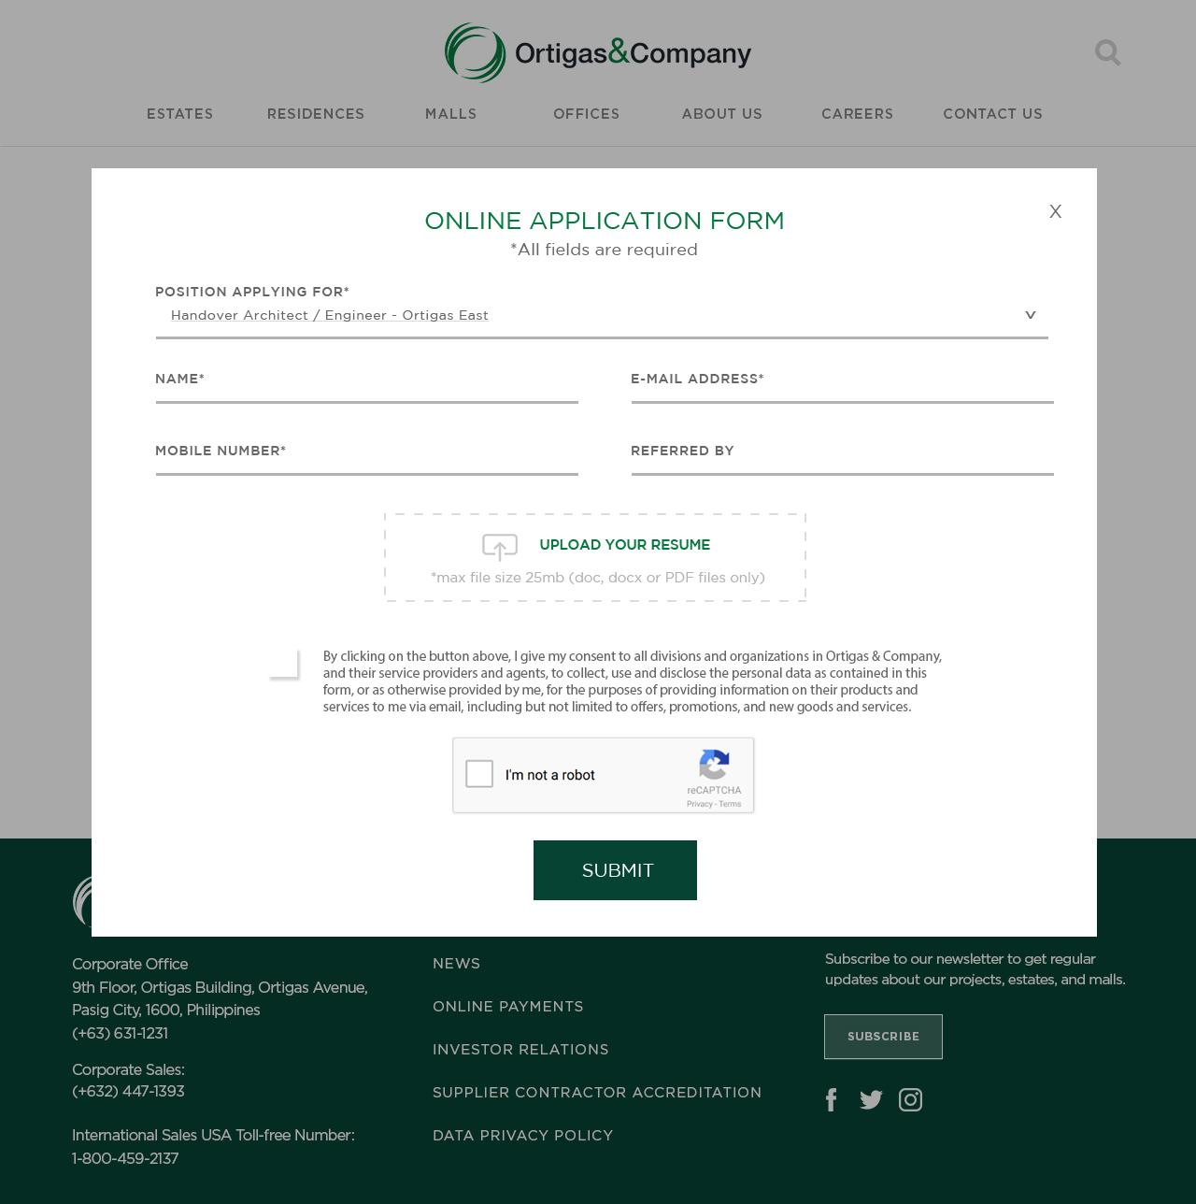
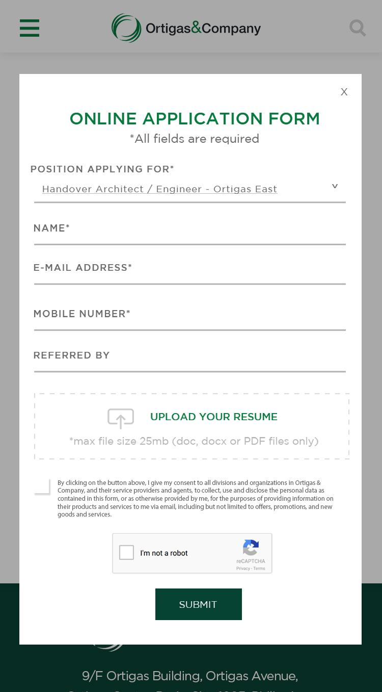
CAREERS – SUBMIT RESUME
10/02/19 v 1.1.0 DOCW-232 - [Desktop][Careers Submit Resume] Different UI
10/02/19 v 1.1.0 DOCW-233 - [Mobile][Careers Submit Resume] Different UI

Slide 34
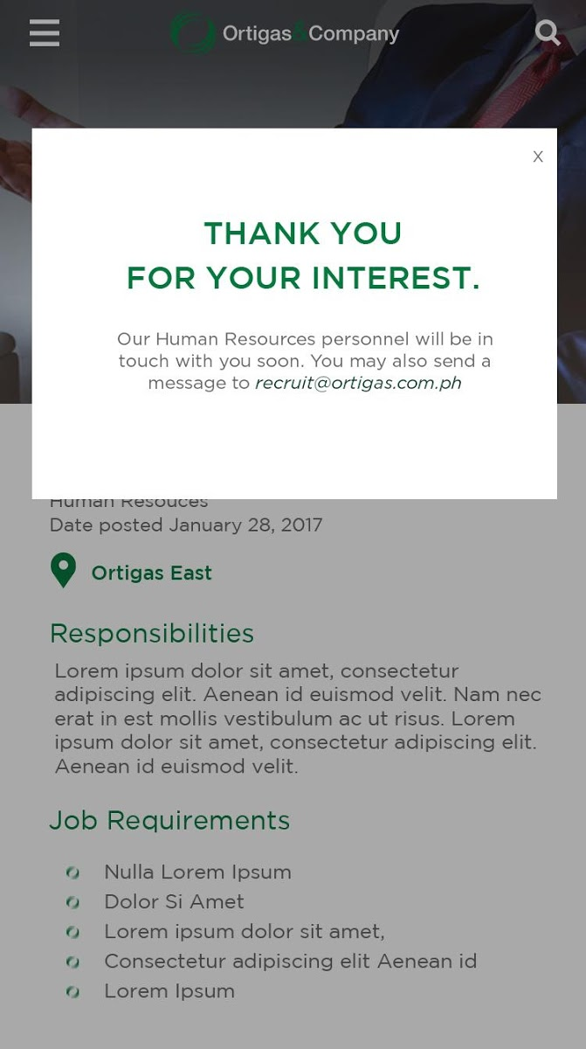
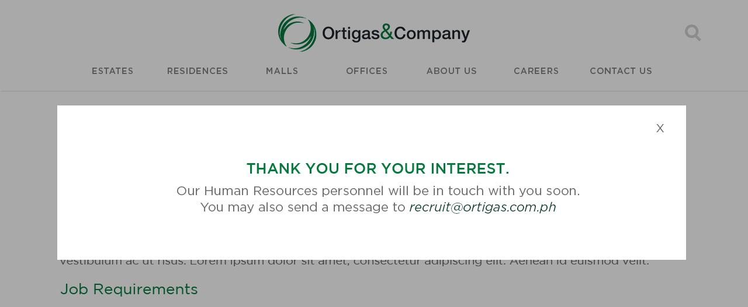
CAREERS – THANK YOU
10/01/19 v 1.1.0 DOCW-216 - [Careers] Online Application Form: Document is required even it has uploaded file

Slide 35
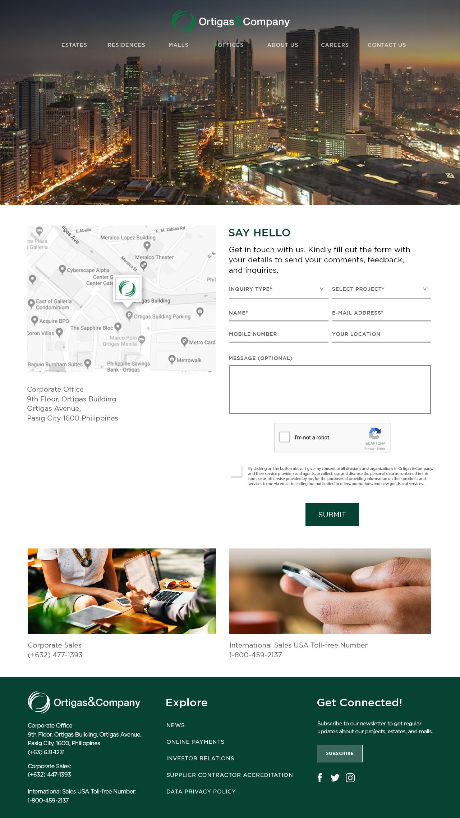
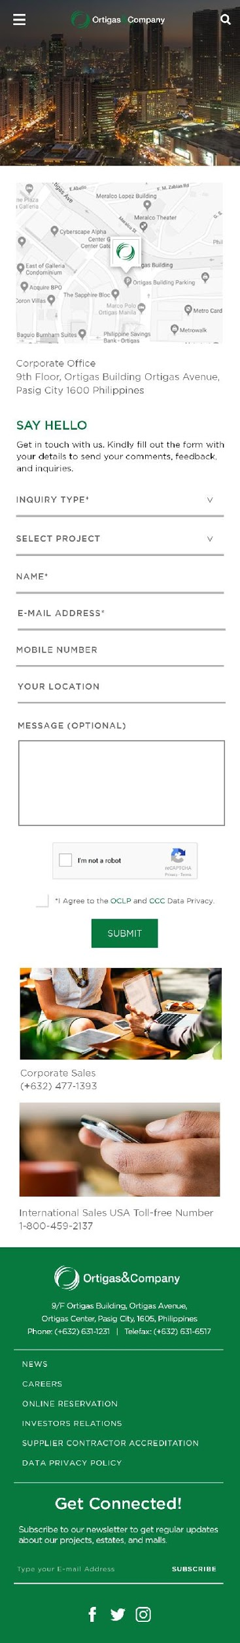
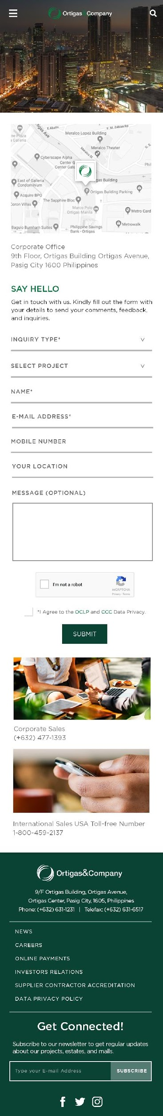
CONTACT US
10/02/19 v 1.1.0 DOCW-234 - [Desktop][Contact Us] different UI

Slide 36
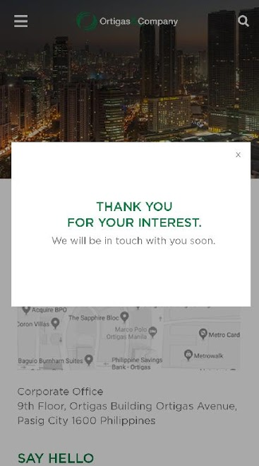
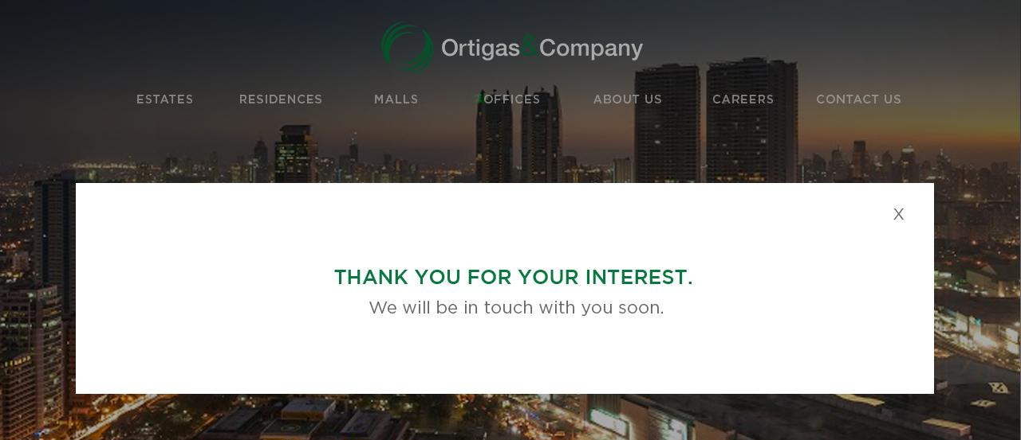
CONTACT US – THANK YOU
10/02/19 v 1.1.0 DOCW-235 - [Contact Us] submit button unresponsive

Slide 37

ABOUT ORTIGAS (DESKTOP)
10/01/19 v 1.1.0 DOCW-212- [About Us] We Are Ortigas included and Missing About Ortigas at the top
10/01/19 v 1.1.0 DOCW-211 - [About Us] Awards should be included instead o Project
10/01/19 v 1.1.0 DOCW-213 - [About Us] related news is included

Slide 38

ABOUT ORTIGAS (MOBILE)
10/02/19 v 1.1.0 DOCW-245 - [Mobile][About Us] Awards should be included instead of Project
10/02/19 v 1.1.0 DOCW-246 - [Mobile][About Us] We Are Ortigas included and Missing About Ortigas at the top
10/02/19 v 1.1.0 DOCW-247 - [Mobile][About Us] related news is included

Slide 39
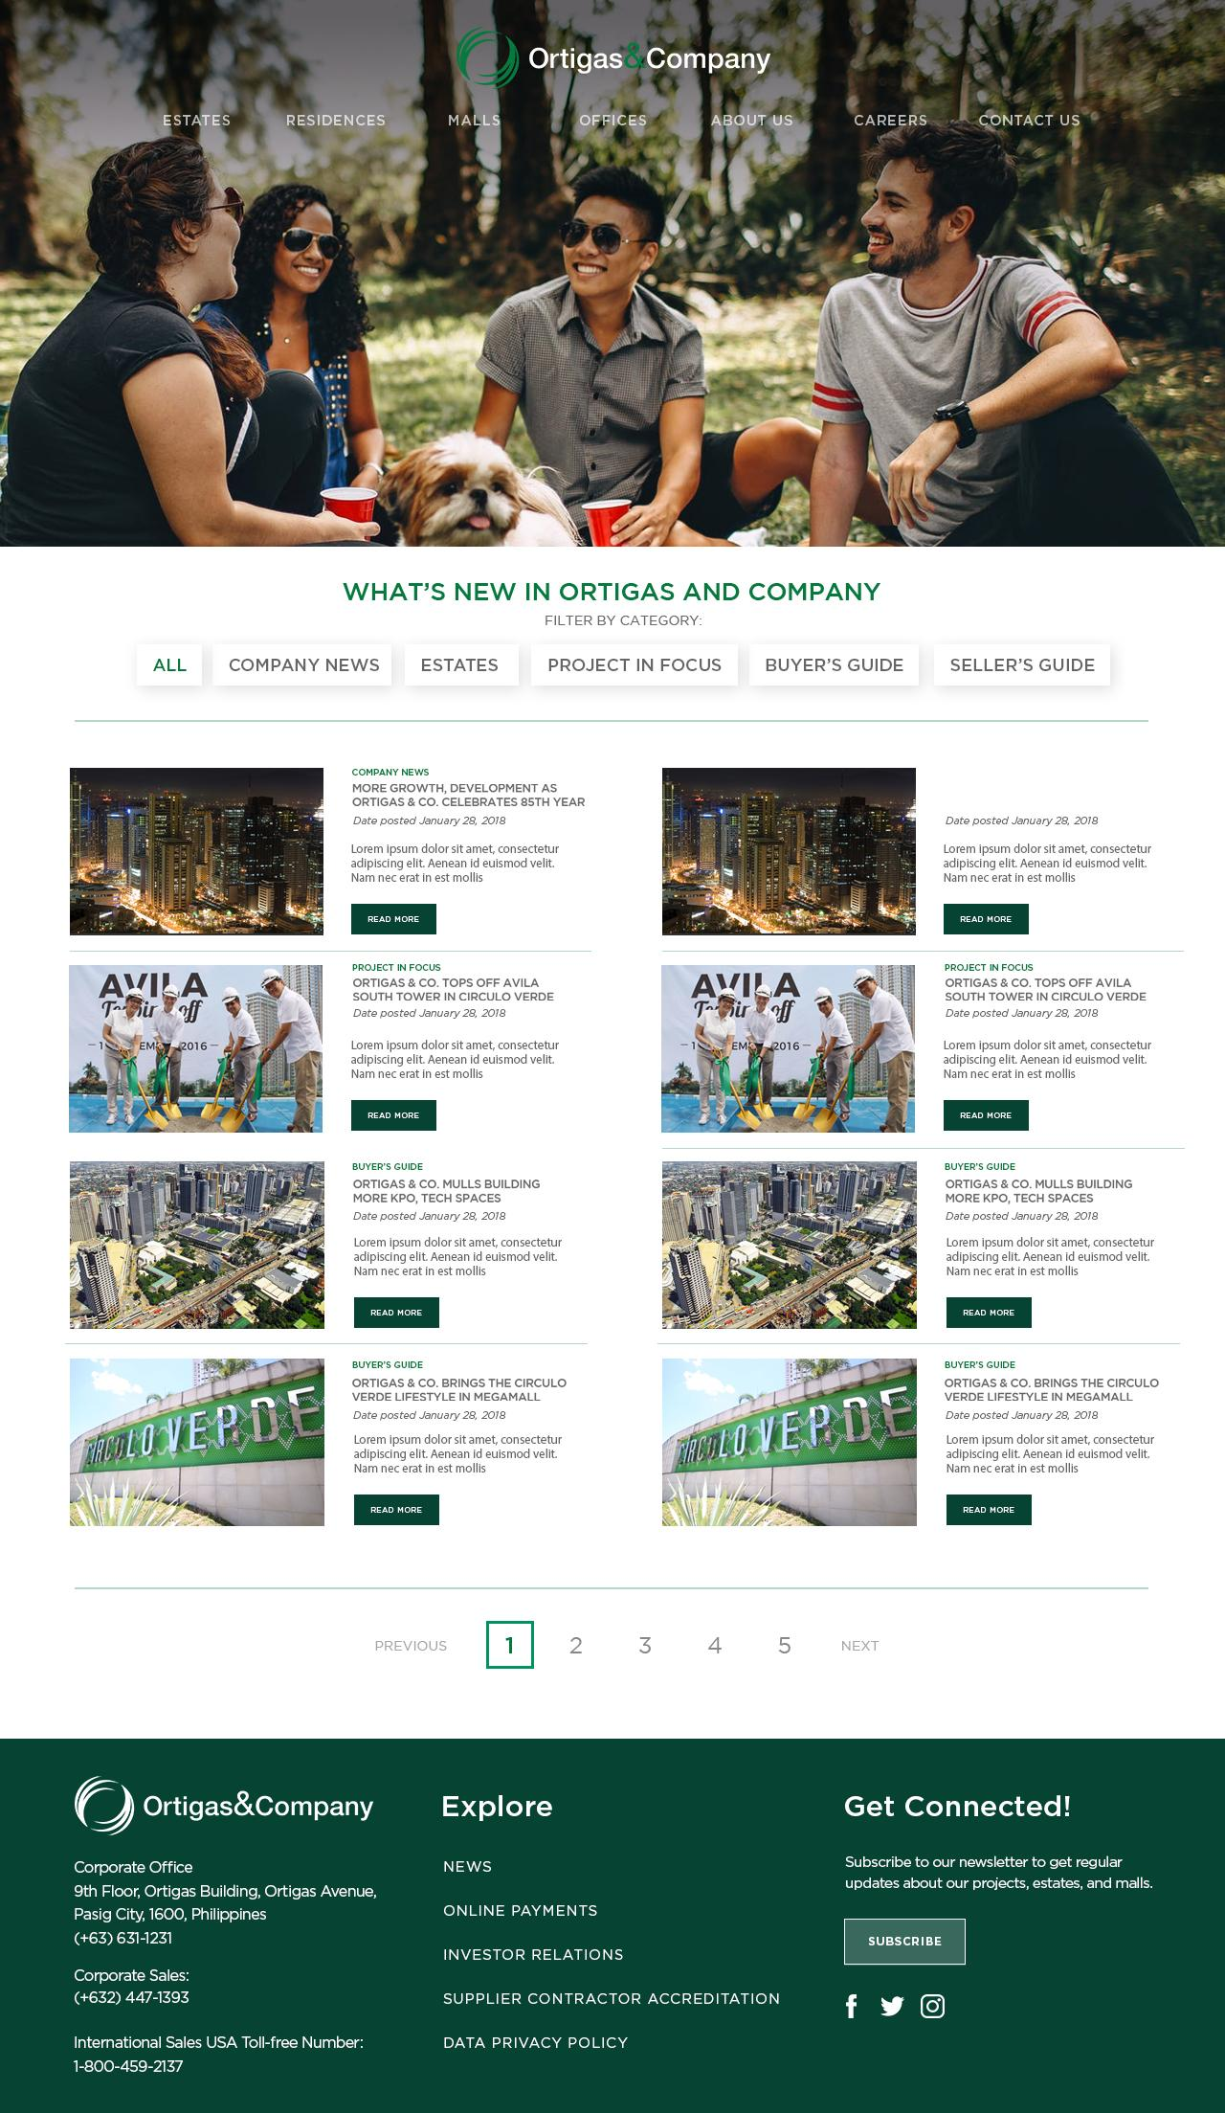

NEWS
10/02/19 v 1.1.0 DOCW-236 - [Desktop][News] Different UI
10/02/19 v 1.1.0 DOCW-237 - [Mobile][News] Different UI

Slide 40
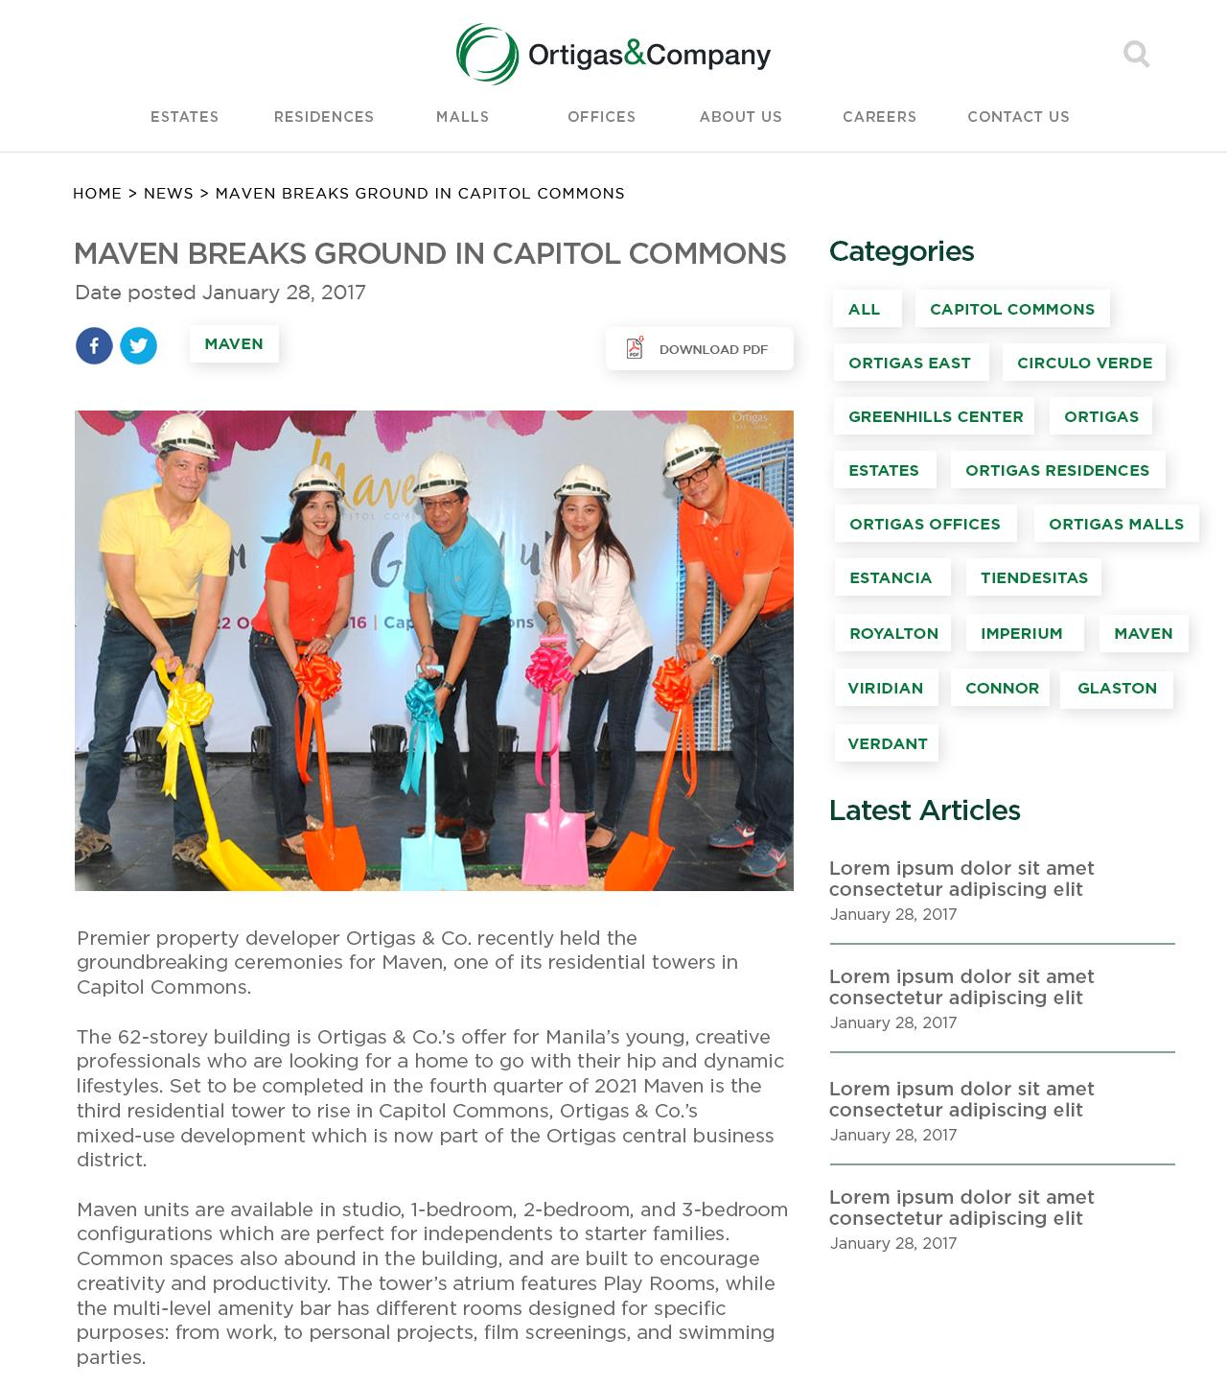
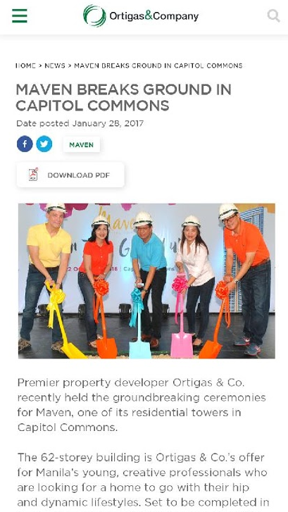
NEWS - ARTICLE
10/02/19 v 1.1.0 DOCW-240 - [News-Article] Different User interface
10/02/19 v 1.1.0 DOCW-241 - [Mobile][News-Article] Different User interface

Slide 41


SUPPLIER AND CONTRACTOR ACCREDITATION
10/02/19 v 1.1.0 DOCW-252 - [Mobile][Supplier and Contractor] Debug Text and Different UI
10/02/19 v 1.1.0 DOCW-251 - [Supplier and Contractor] Debug Text and Different UI

Slide 42

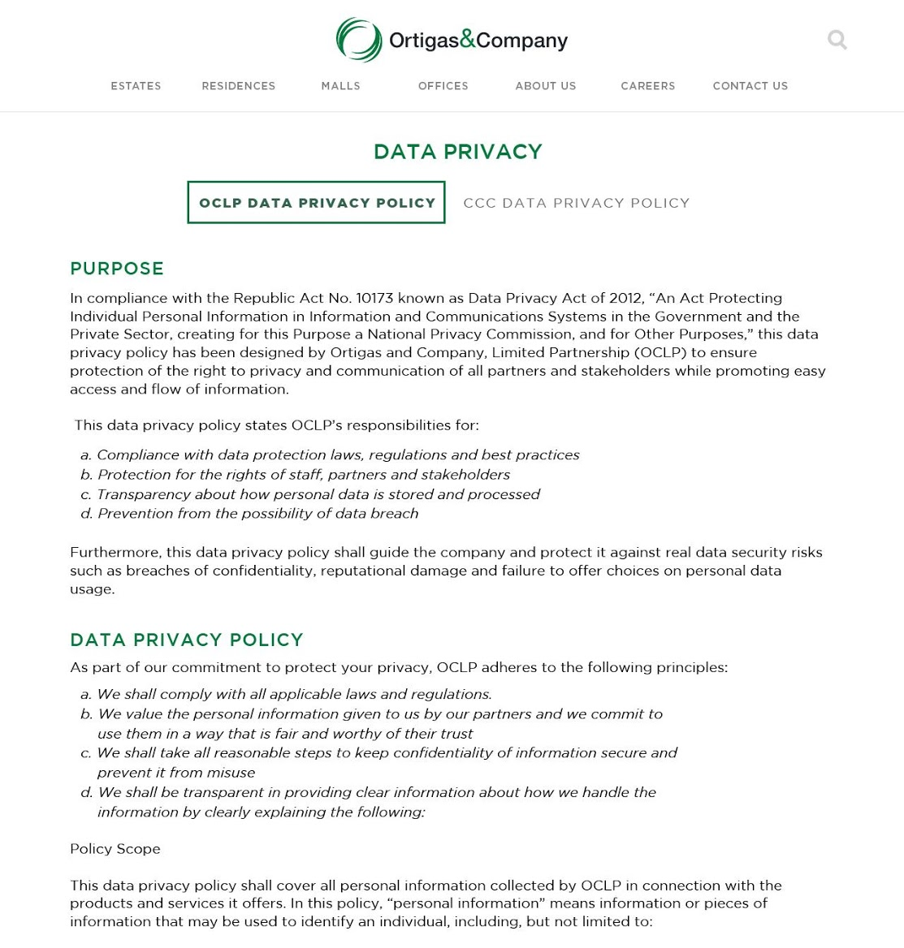

DATA PRIVACY POLICY

